Slide 1

Connecting to the Middle Schooler
Mr. Clint Daniels
Indian Trail Middle School
7th Grade Language Arts
cdanielsit@olatheschools.org
theteachersdevotional@gmail.com

Slide 2


You Might Be a Middle School Teacher
If you repeat yourself more than a broken record, you might be a middle school teacher.
If you are teaching conjunctions and your class snickers when you mention the word “but,” you might be a middle school teacher.
If you ask the class if they think the relationship between Pony and Cherry will work out, and someone responds, “I think Pony will pop her cherry!” you might be a middle school teacher.

Slide 3
You Might Be a Middle School Teacher
If banging your head against the wall is therapeutic at the end of the day, you might be a middle school teacher.
If a student declares he enjoys eating glue, you might be a middle school teacher.
If a boy steals your beanbag, puts it on his back, and crawls around the floor declaring he is a turtle, you might be a middle school teacher.
If a boy flirts with a girl by plucking hairs out of her ponytail, you might be a middle school teacher.
If you are reading a research report and find out that an entire PowerPoint slide was copied and pasted from the internet, you might be a middle school teacher.
If you witness four boys holding hands, circling themselves around a victim, saying, “Ooga booga, ooga booga” to sacrifice them, you might be a middle school teacher.
If you tell your class to get started on their homework and you notice one girl is gazing at LaMello Ball’s Instagram page, you might be a middle school teacher.

Slide 4
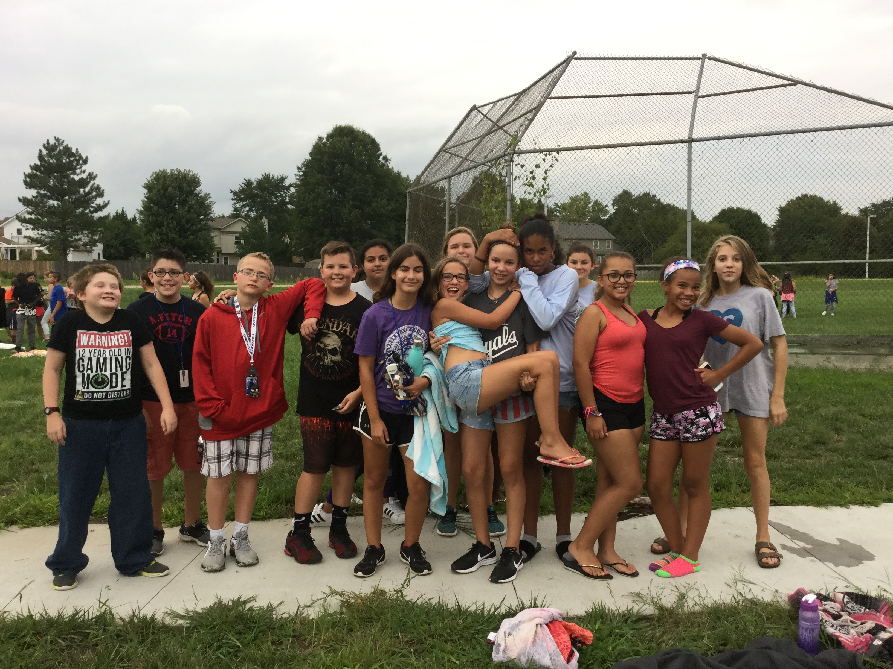
What Connects You To Your Teacher?

Slide 5
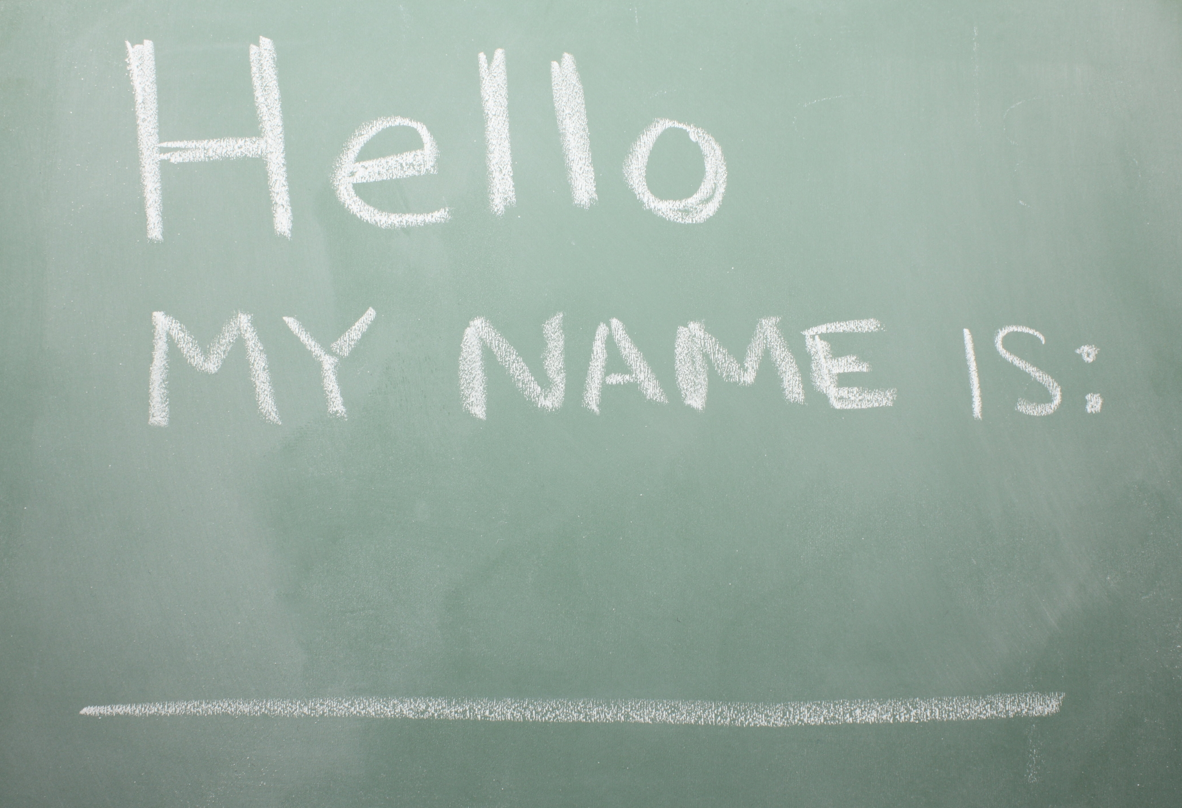
How to Memorize Names?
Connect names to interests
Use pictures on gradebook
Use names as much as possible in class (greet at door)
Say every student’s name at least once per class
Use a seating chart
Memorize by end of first week
Smack yourself if you miss names after that

Slide 6

Use Nicknames!!!
When you have more than one student with the same name
Always approve through student
Favorite nicknames through the years:
  Girl With the Cool Pants
  Taco
  No Sleep Till Brooklyn
  Darth Zaeder
  Shane the Train
  Turtle Boy
  Grinchy
  Milli Vanilli

Slide 7

Share About Weekends!
Set timer for 2 minutes on Friday and Monday
Friday: What are you doing over the weekend?
Monday: What did you do over the weekend?
One sentence if timer goes off and hands still raised
Ask questions following comments
  Went to movies = what movie?
Share about your own life
Practice now

Slide 8
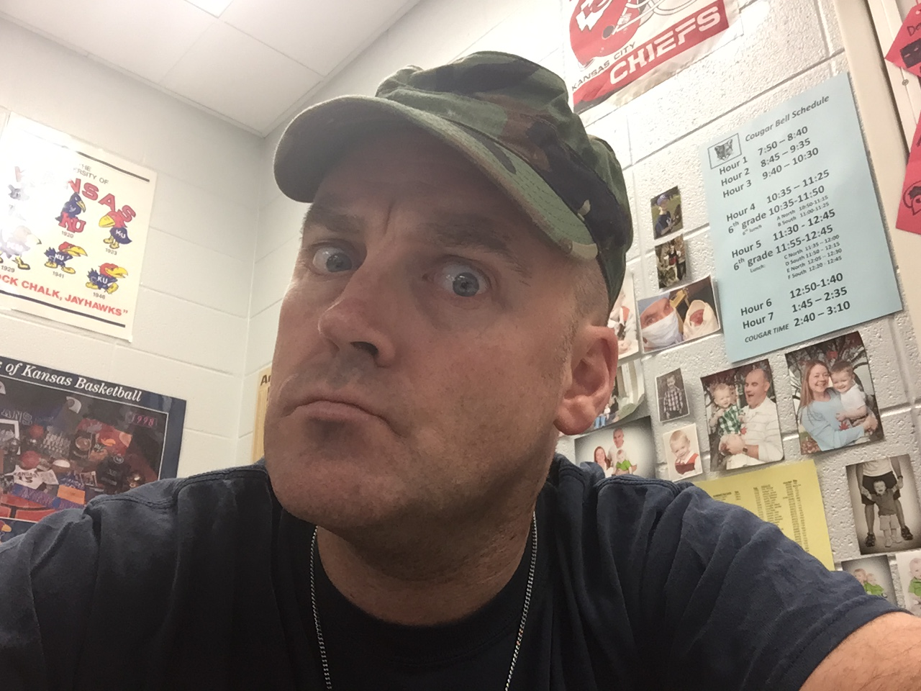
Practice Rules and Procedures
Put kids through Rules and Procedures Boot Camp
If they get it wrong, redo it!
Make skits over rules
Have class sign contracts about rules
Be consistent

Slide 9
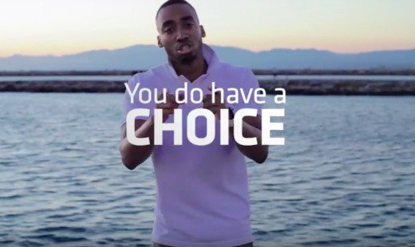
Character Lesson: Technology

Slide 10



Student Interests
Get-to-know-you games (That’s Me, scavenger hunts, ask favorites)
Put student interests into your lessons (YouTubers, Netflix, Video games, etc)
Create games with them (snowball fight)
Have students write about them (personal narratives, bell work, etc)
Decorate your walls with them (posters, displays, etc)
Study them so you can discuss them yourself

Slide 11
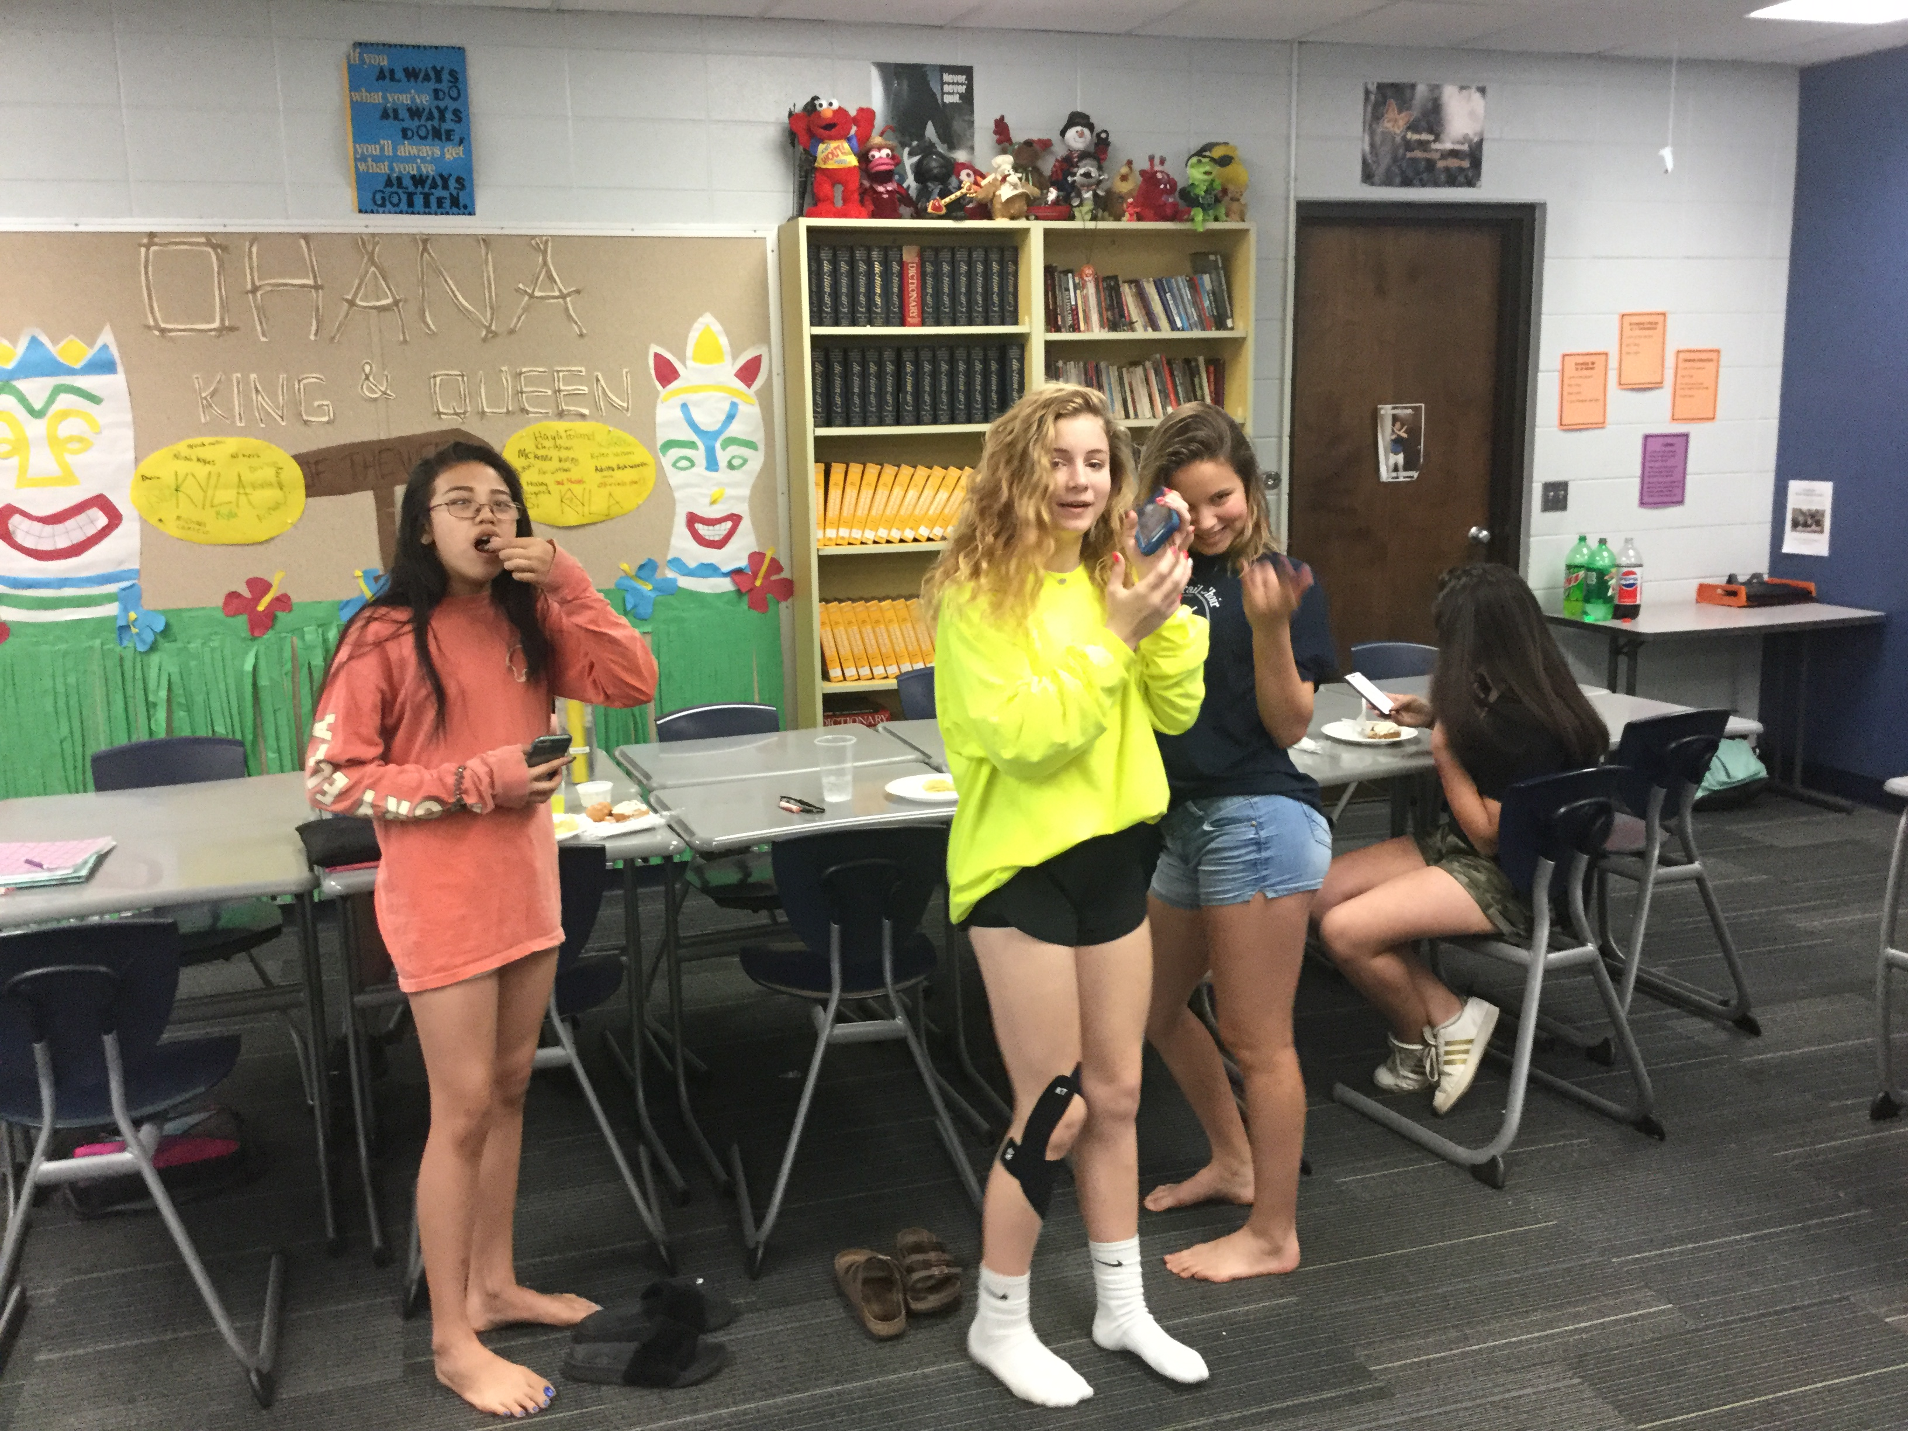
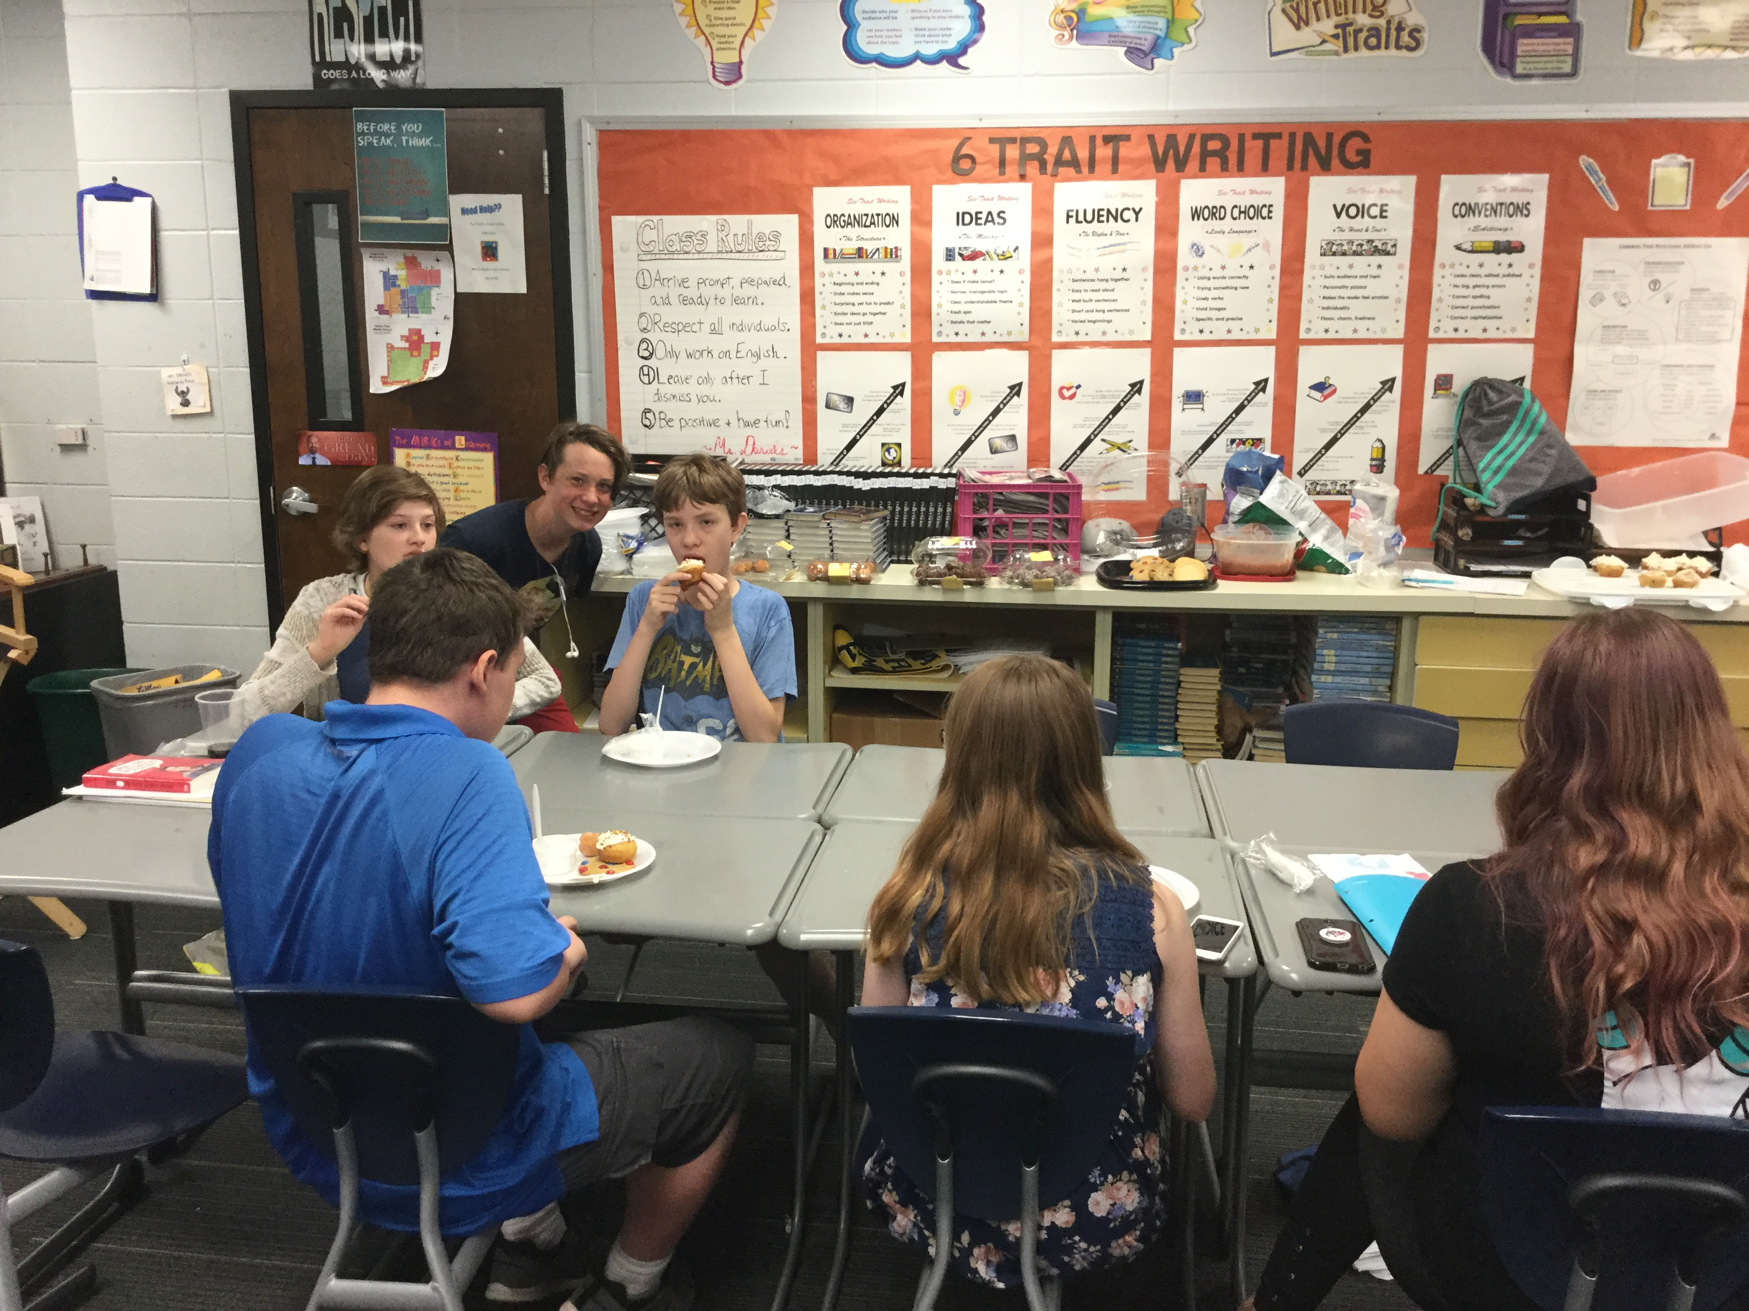
Dine With Daniels
Takes place every Friday
Students bring lunch back to classroom to eat
Watch fun videos
Play music
Let your guard down
Ask students questions
Show a movie over a period of a week
Share food
Compliment trains
Stay entire time; don’t let roam hallways!
Clean up!

Slide 12

Mentoring
Choose needy student
Meet in library for lunch
Mentor them
Provide counsel
Check grades
Play cards or video games
Teach life lessons
Communicate with parents
Can do this with other students too
Personal success stories

Slide 13
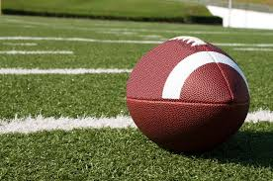
Personal Stories: Last Football Game

Slide 14
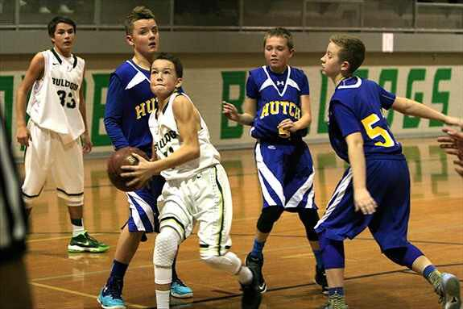
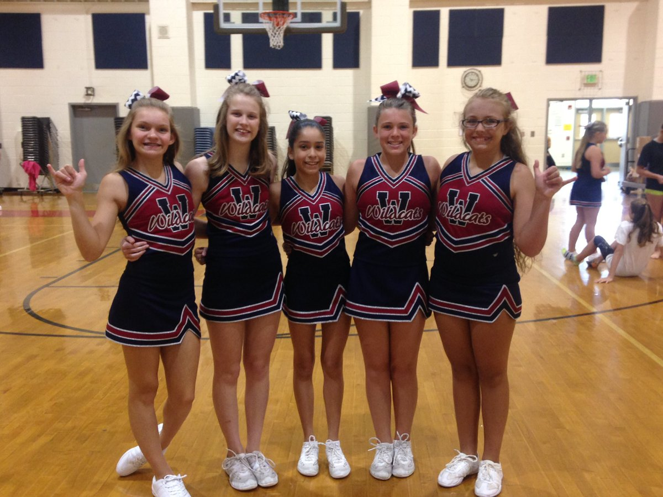
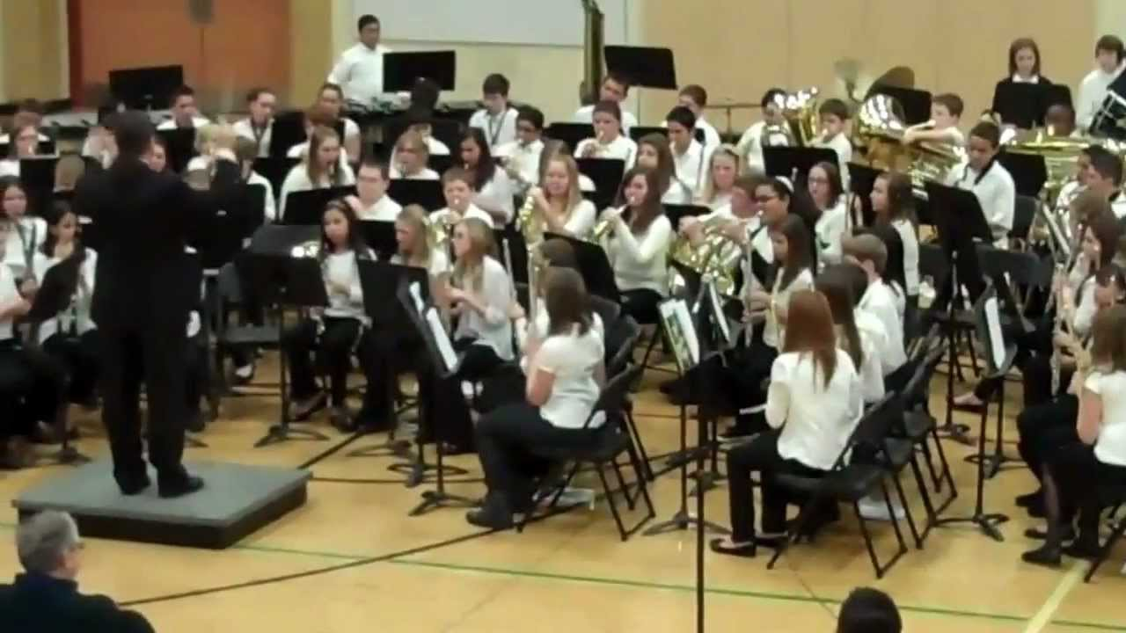
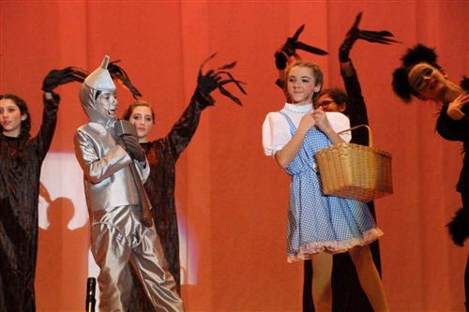
Attend Events
Sporting activities
Drama performances
Concerts
Cheerleading/dance team Competitions
Don’t have to stay whole time
Quick wave then leave

Slide 15
Notes of Encouragement
Dear Johnny Student,
I wanted to write you to let you know how much I have appreciated your efforts recently. That presentation you gave last week was not only creative—it was one of the best! I am so glad you are finally hitting your stride. You are on the right track, and I will look forward to seeing more amazing things from you. Keep up the amazing work!
Ohana forever,
Mr. Daniels
Our team writes notes every Thursday
Mail out from office
Be sincere and give honest praise and encouragement
Write notes on graded papers
Write notes to challenge students that are underachieving
End school year by writing a personal note to ALL students
Start early! Like in April

Slide 16

Shout-outs In Class
Write student praises on board
Verbal recognition
Have kids tell what others did well after presentations
Quiet kids: off to side recognition
Rock star/Ohana passes

Slide 17
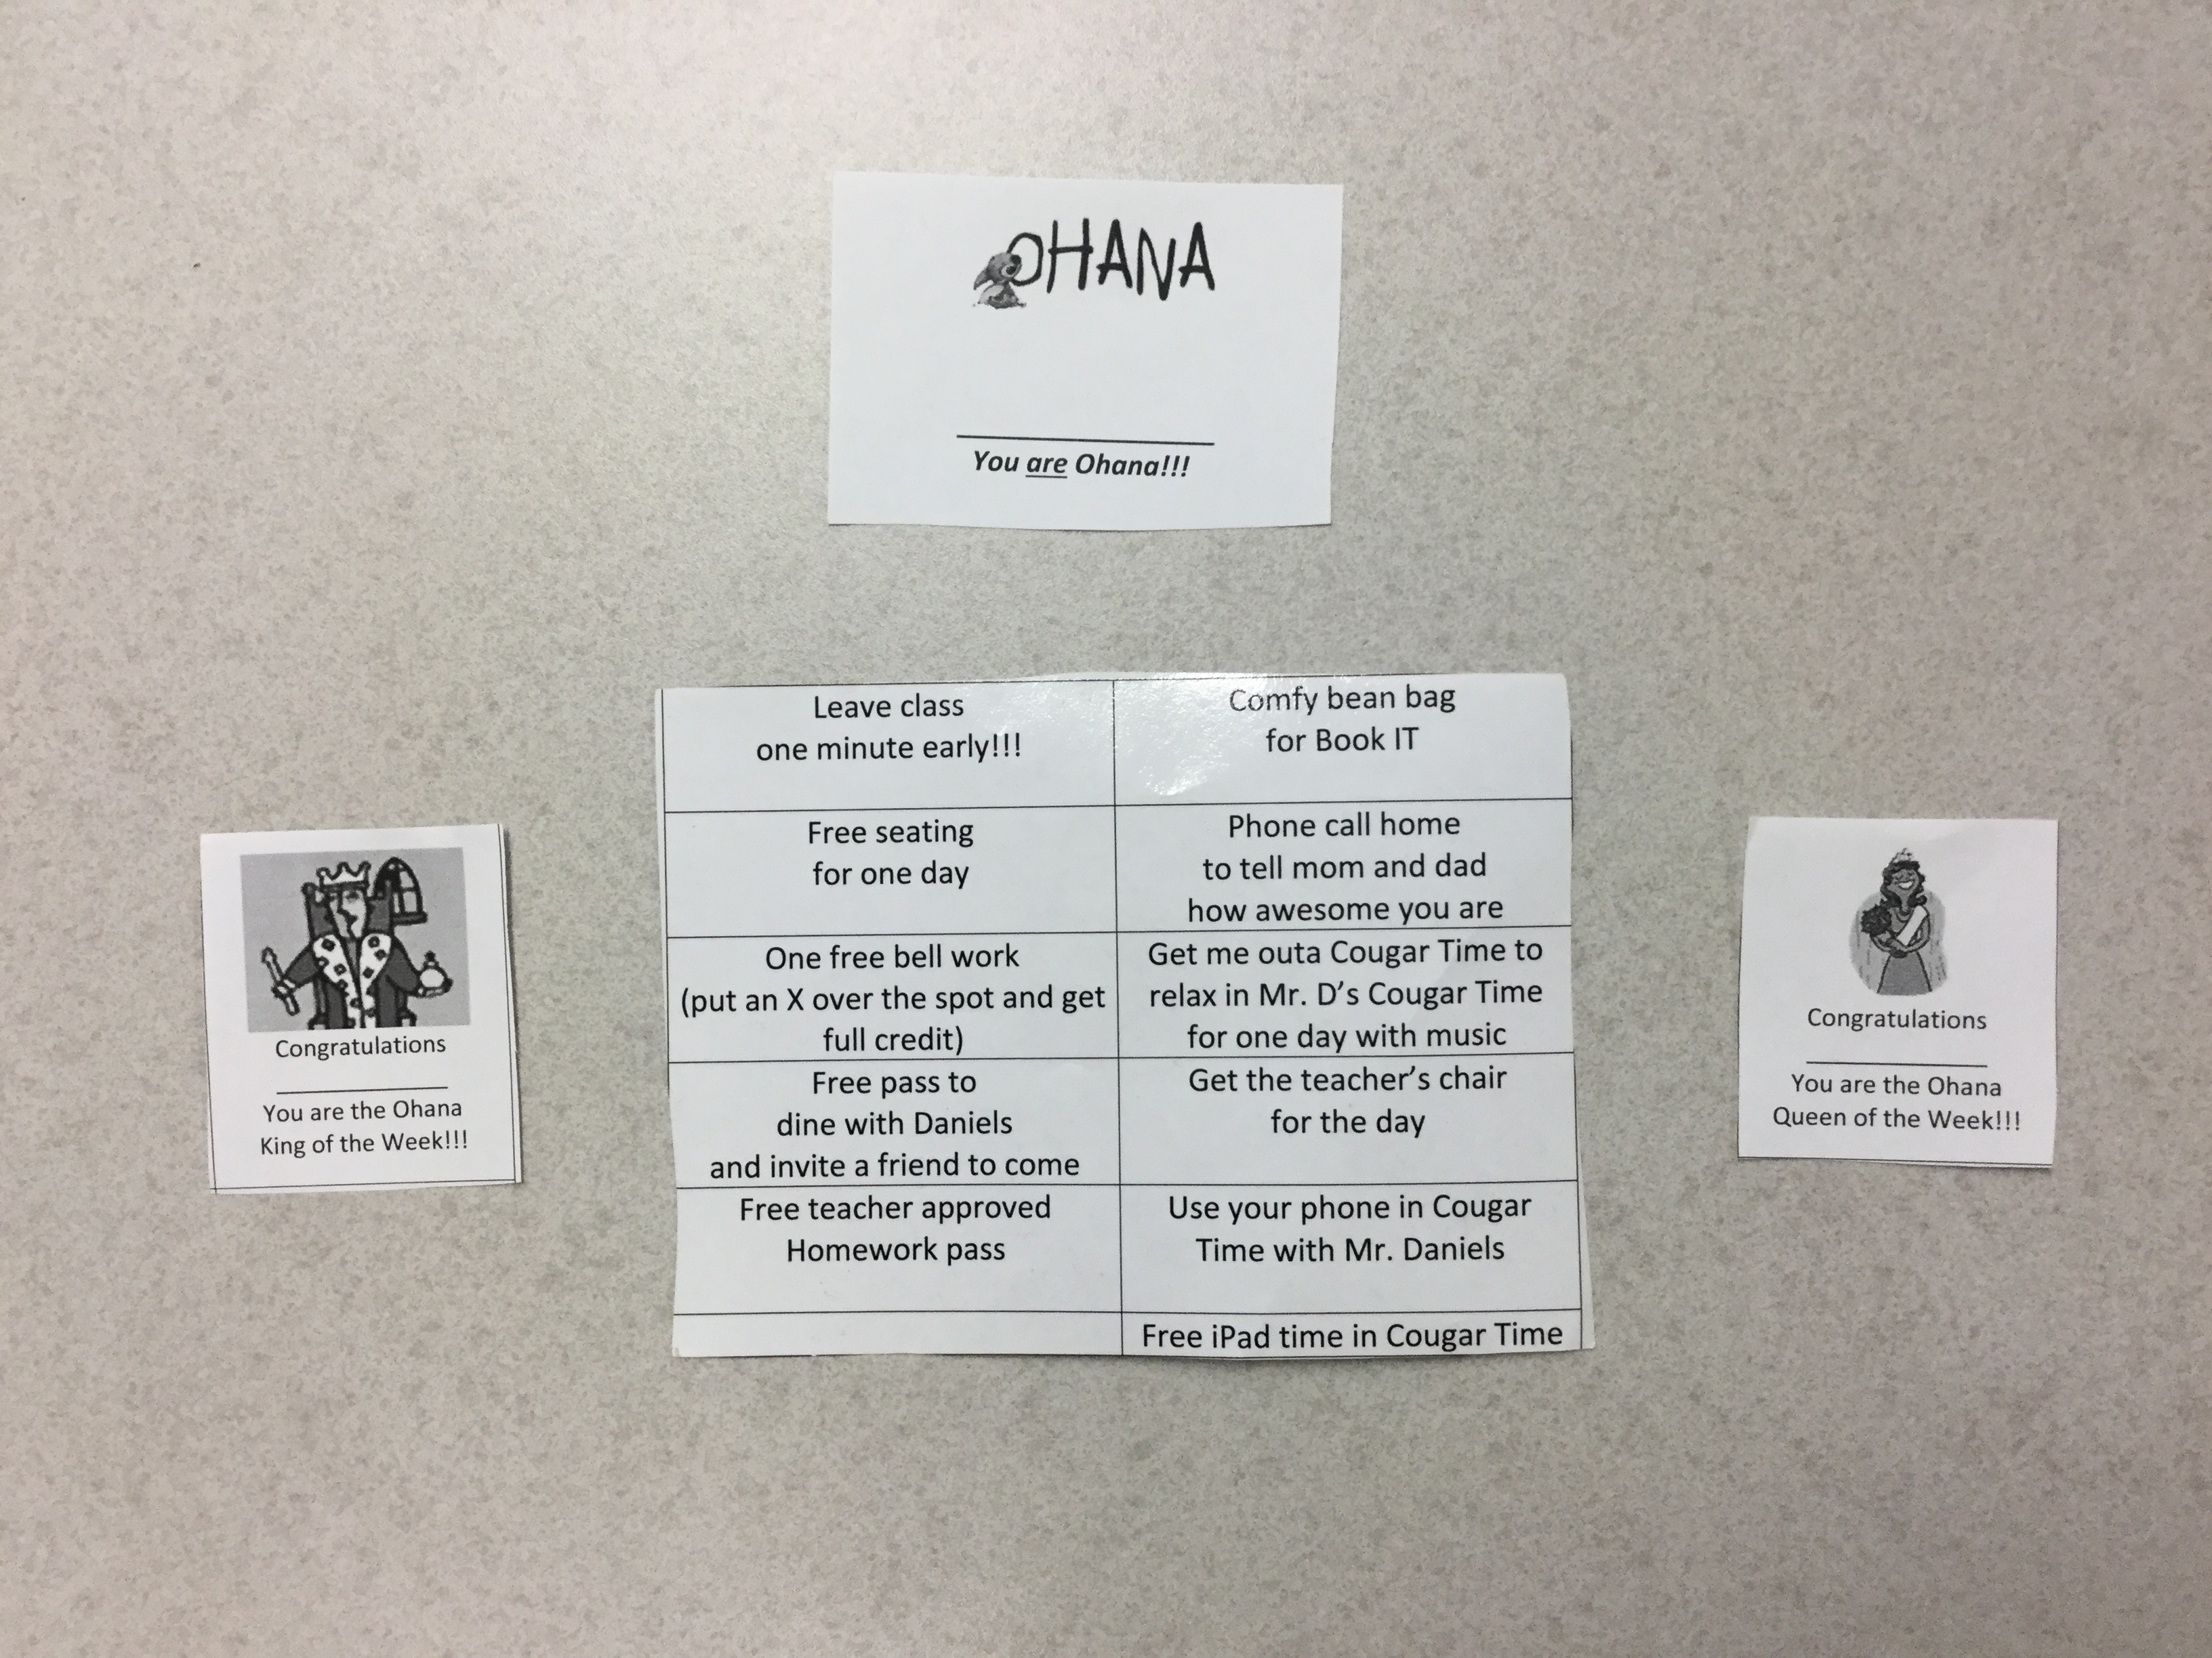
Ohana Passes
Write student name on pass
Put into blue bucket for raffle
Win Prizes on Friday!!!
Let King or Queen pick

Slide 18
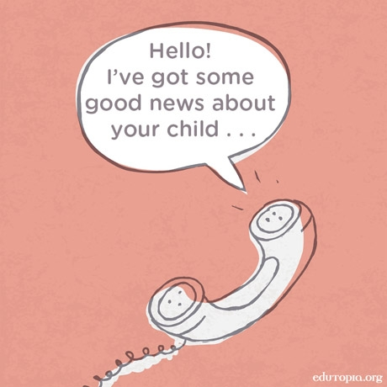

Positive Parent Phone Calls
Call home to praise over successes
I make 5 positive parent phone calls every Friday
Some parents have never heard the positive ☹
Positive parent call → parent rewards child → better class productivity from child

Slide 19
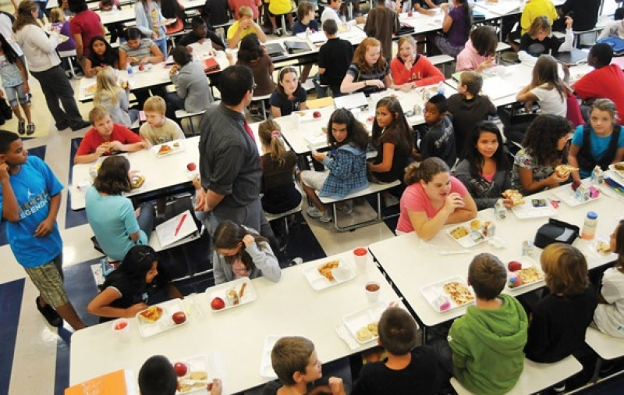
Past Students’ Stories: Hannah’s Story

Slide 20


Connect Through Music
Play songs as students come in
  School appropriate (no bad words!)
  Mix it up! Use all styles (70’s, 80’s, 90’s, today)
  Choose a song for specific theme of day (“The Outsiders” by Needtobreathe)
Use a song to teach a life lesson
  “Words” by Hawk Nelson or “Forgiveness” by Matthew West
Let students choose songs for projects
  Connect songs to themes in class
  Write own lyrics to songs and perform!
Create your own songs
  Lit Device Rap Song????

Slide 21
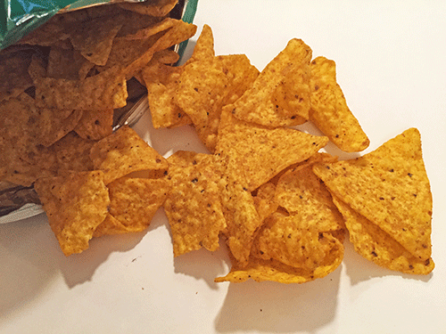
Don’t Cry Over Spilled Doritos!

Slide 22

Be a Counselor
Not in contract, but still EVERY teachers job
Notice when students look upset; be proactive!
One eye in, one eye out talk
Offer your time to counsel
  Before or after school; plan periods
Call student into team plan hour
Call home if needed
Story of most impactful moment of counseling

Slide 23
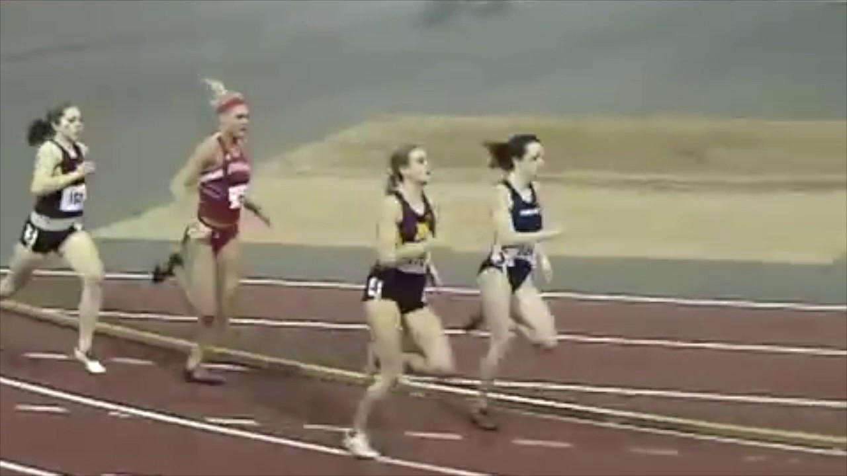
Character Lesson: Never Quit!
Check out more character lessons at www.theteachersdevotional.com under the “character lessons” tab at the top of the page.

Slide 24
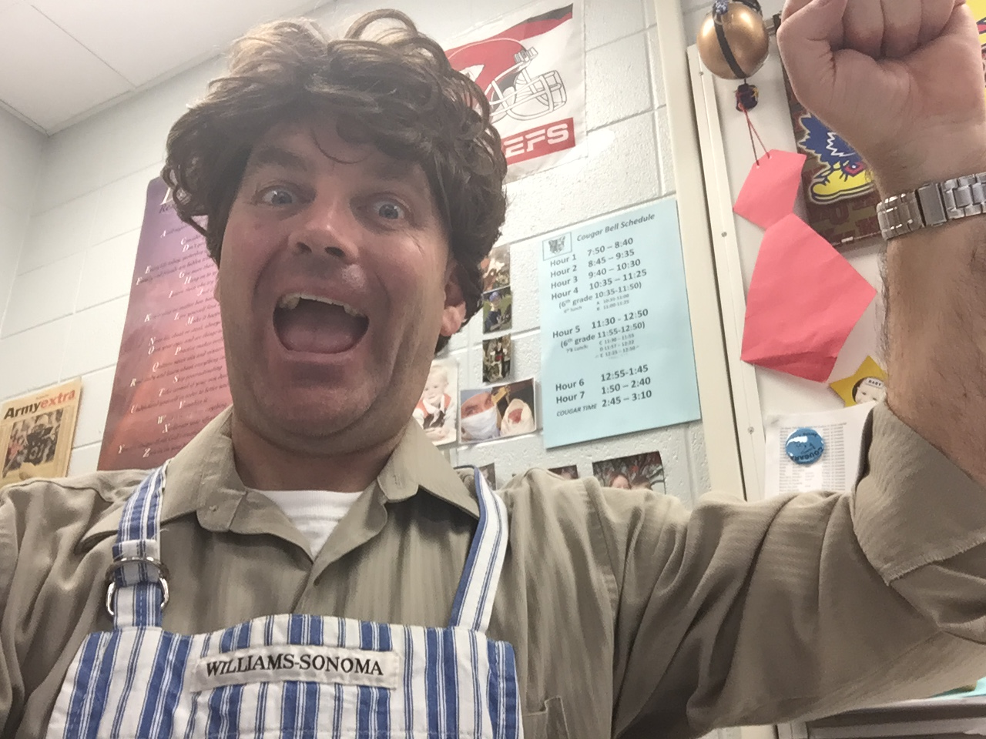
Use Humor!
Try using their lingo
  That was totally lit! (Translation: That was really neat.)
  Don’t get all savage on me. (Translation: Try not to be disrespectful.)
  Boi! (Translation: What the heck did you just say?)
Tease the ones who like to be teased
  Confident, class clowns
  Kids with thick skin
Make fun of yourself (Brought to you by the brilliant yet balding people of Daniels INC)
Have guest speakers (aka you in costume)
  Captain Daniels
  Pierre
  Dude
  Dr. Cringeworthy
  Valley Girl (5:10)

Slide 25

Project Based Learning
Zombie Apocalypse Project
A Long Walk to Water: the Water Project
Kids broke into groups
Separate groups for:
  Brochure
  Demonstration
  Presentation
  Poster

Slide 26
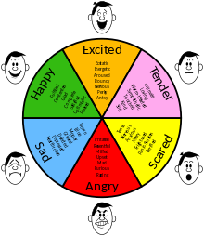
Be Real!
Okay to humble yourself
Tell students about shortcomings
  Cheating on test
  Bullying
  Stole Cadbury Easter egg
Don’t lie
Okay to show emotion
  Grandma’s death
  Brother injured in Iraq
Makes students feel mature/older
When you are real, they are real

Slide 27

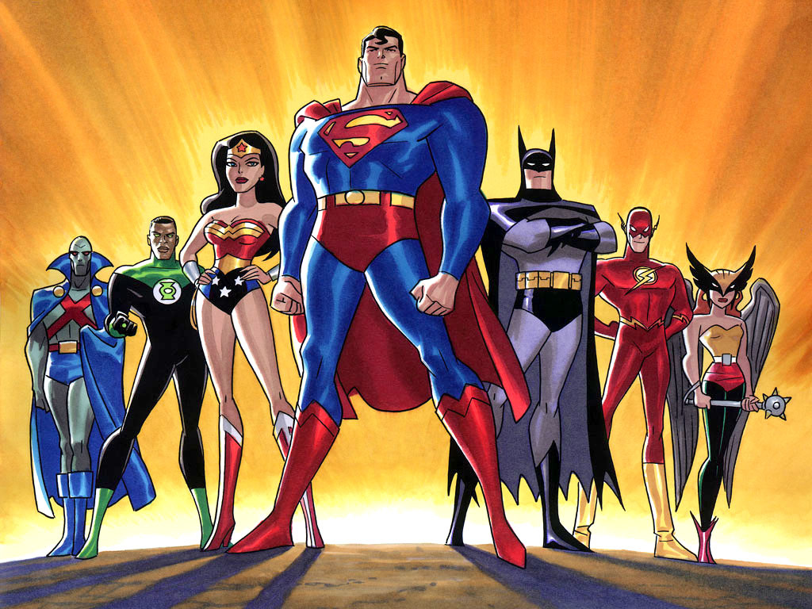



Class Challenges
Classes all compete against each other; 4 per year
Kids choose fun theme and mascots (Olympics, celebrities, Ninja Turtles, Pokemon characters, food, superheroes, YouTubers, etc)
Daily challenges to earn points (class expectations, curriculum, goofy fun, class averages on HW, trivia, etc)
Allow bets with two weeks left
Small rewards through quarter (free seating, candy, etc)
Positive peer pressure helps!
Winning class gets class party

