Slide 1
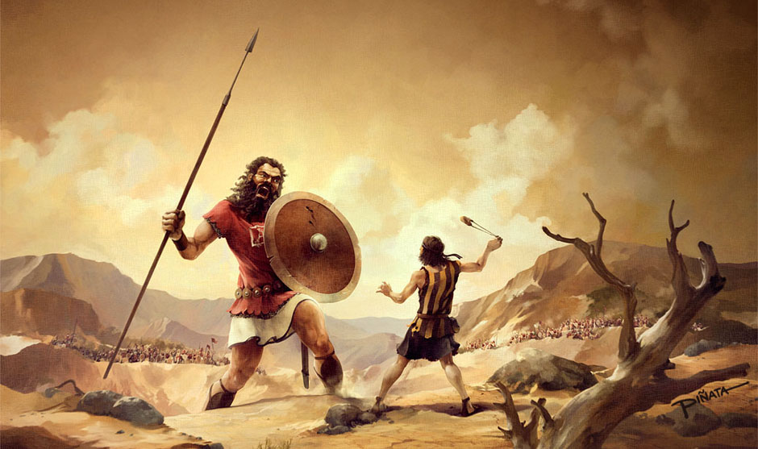
Underdogs
Stories of encouragement brought to you by FCA

Slide 2
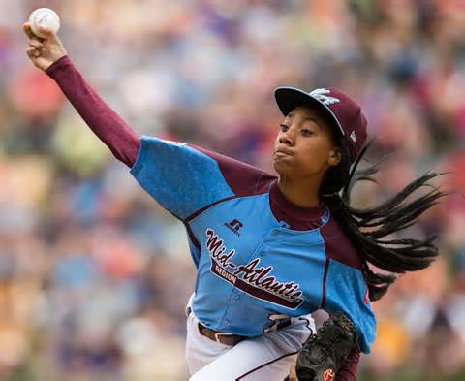
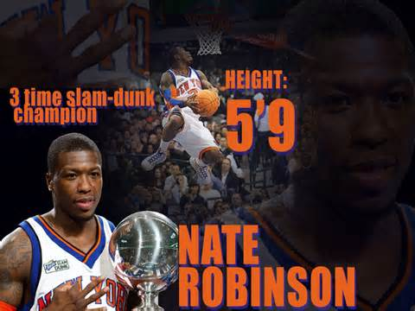
Has anyone ever doubted you on the field of play or in life?
Maybe someone says you’re too short or too slow or too weak.
Maybe someone says you can’t do something because you’re a girl.
Whatever the case may be, let the stories of Mo’ne Davis and Nate Robinson inspire you.

Slide 3
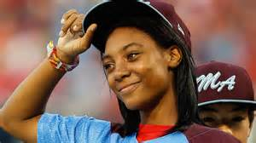
Mo’ne Davis proved that girls can hang in there with the boys.
Plenty of boys doubted her, but she took her team to the Little League World Series.
This is her story: https://www.youtube.com/watch?v=RuUphY-nfu4.

Slide 4
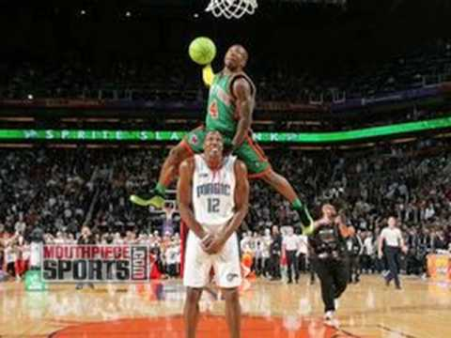
Nate Robinson proved he could dunk with the best NBA players.
Little Nate Robinson was only 5’9’’, but he won not one, not two, but three NBA slam dunk championships.
His most memorable dunk was a high flying jam over NBA center Dwight Howard. Check it out here: https://www.youtube.com/watch?v=RjDmyW4RJ64.

Slide 5
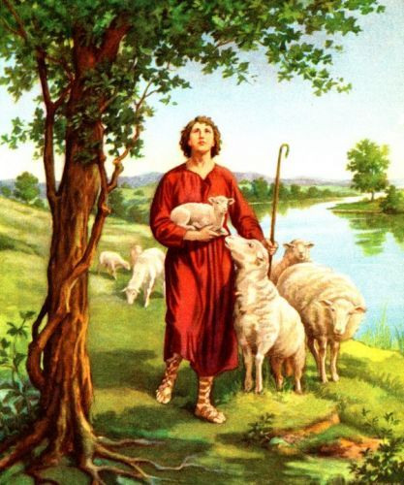
What does the Bible say about being an underdog?
It is clear that God does not judge us based on our size or strength.
Samuel was looking for a new king to replace Saul. He was shocked when God told him what He was looking for.
“But the Lord said to Samuel, ‘Do not look on his appearance or on the height of his stature, because I have rejected him. For the Lord sees not as man sees: man looks on the outward appearance, but the Lord looks on the heart’” (1 Samuel 16: 7).

Slide 6
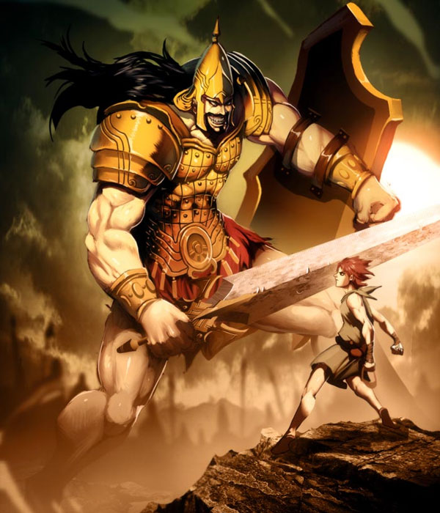
The story of David vs. Goliath
Soon after David was chosen by God to be the new king, a Philistine by the name of Goliath tormented the Israelites.
Goliath, standing nearly 10 feet tall, came to the edge of the camp daily, challenging the Israelites to send their best fighter out.
Nobody took the challenge—that is until David came along.
David calmly gathered five smooth small stones, put them in his pouch, and confronted Goliath with a mere sling.
Goliath laughed at little David, a scrawny 17-year-old shepherd, but David launched a stone that struck and killed Goliath.
David finished off the bully by taking Goliath’s own sword and cutting off his head.

Slide 7

Main points about underdogs …
You will always have people who doubt you in life.
Prove people wrong through your own Godly character and actions.
Let your play on the field do the talking—not your mouth.

Slide 8
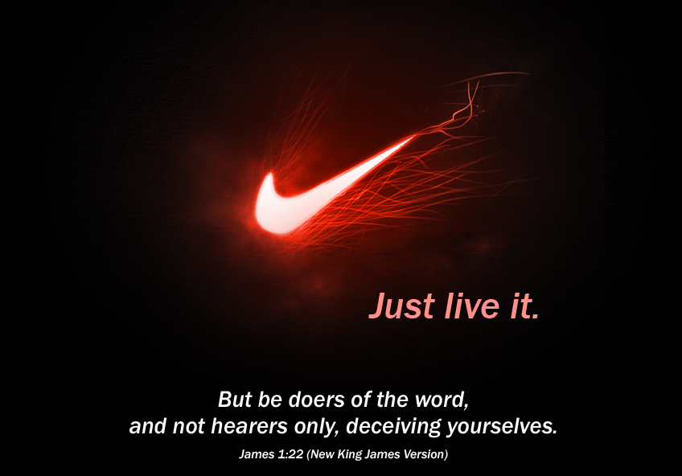
Questions to think about …
Have you ever been doubted in life? How did you respond?
How do you think God wants us to respond to people who doubt us?
What matters more: words or actions?
Final thought: “But be doers of the Word, and not hearers only, deceiving yourselves” (James 1: 22).

