Slide 1

Staying positive
An uplifting message brought to you by FCA

Slide 2
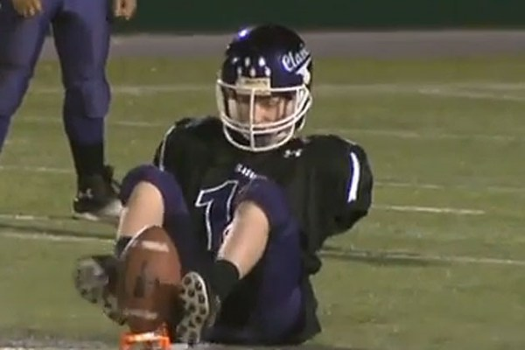
Do you ever feel sorry for yourself when something goes wrong?
Maybe you should reconsider how you feel and be grateful for what God has blessed you with.
Check out this amazing story: https://www.youtube.com/watch?v=vQbLlHqcjtM

Slide 3

Staying positive in sports …
Bad things are bound to happen on the field of play.
If you don’t keep a positive attitude while competing, your teammates will be down.
Be a leader and always look to the bright side!

Slide 4
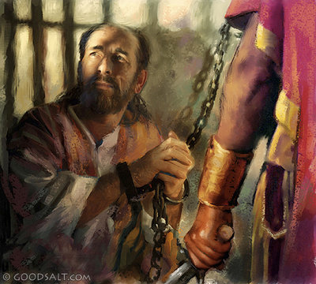
What does the Bible say about being positive?
Paul knows a thing or two about staying positive. This was a man who was shipwrecked, thrown in jail, beaten, and nearly stoned to death, but he always praised God no matter what.
In Philippians 4: 8, Paul says, “My friends, whatever is pure, whatever is honest, whatever is right, whatever is pure, whatever is holy, whatever is of good repute, if there is any excellence or if anything worthy of praise, dwell on these things.”
I challenge you to put this verse to memory and recite it every time you feel down.

Slide 5

The story of Joseph
The story of Joseph tells a story of a kid who remained positive through all his struggles.
Joseph’s brothers left him for dead in a well and sold him into slavery.
Joseph also was put into prison for being accused of something he never did.
Through all his struggles, Joseph remained positive!
He accepted God’s will and left a legacy that is still being shouted out today.
Plus, if you had a coat like this, wouldn’t you be smlining too?

Slide 6
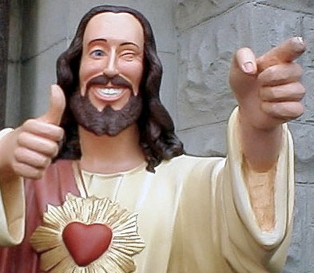
Main points of being positive …
We must find ways to think positive!
When things go wrong, keep the faith!
Positive thinking makes your day go better.

