Slide 1

Spiritual gifts
A word of encouragement brought to you by FCA

Slide 2
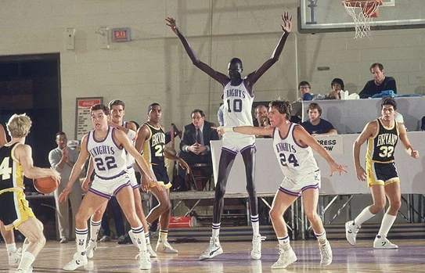
Think about the following questions …
If you were playing basketball, would you ever want your center to shoot 3-pointers all game?
Would you want your 5’8’’ guard posting up against someone who was 6’5”?
The answer is easy … NO! You would want your team to play a position that would most help your team.
That is why the guards are the quick ones that bring the ball up the court, and the low post players stay down low.
What position would you have number 10 playing if you coached his team?

Slide 3

The most gifted team of all time?
This would be debatable, but many could make an argument that the 2008 Kansas Jayhawks were the most gifted team ever.
They had all the talent in the world, and every player played a role in their success.
Coach Bill Self never knew who would be his leading scorer. Eight different players led the team in scoring throughout the season in different games.
Check out their highlights below!
https://www.youtube.com/watch?v=pPpcqKpLss8&ebc=ANyPxKpVWSIsm9jZliuXEwpJt93NCNP-8aTHOmzfDsUVOYIquBf_giiKk0ELPj36wsf8OnjN0nJ-l3-nL18g7TTBHcJwaeCQyQ&nohtml5=False

Slide 4

What does the Bible say about spiritual gifts?
“There are different kinds of gifts, but the same Spirit distributes them. There are different kinds of service, but the same Lord. There are different kinds of working, but in all of them and in everyone it is the same God at work” (1 Corinthians 12: 4-6).
“Just as a body, though one, has many parts, but all its many parts form one body, so it is with Christ” (1 Corinthians 12: 12).
“Don’t let anyone look down on you because you are young, but set an example for the believers in speech, in conduct, in love, in faith and in purity” (1 Timothy 4: 12).

Slide 5

What are the spiritual gifts?
“Now to each one the Spirit is given for the common good. To one there is give manifestation of n through the Spirit a message of wisdom, to another a message of knowledge by means of the same Spirit, to another faith by the same Spirit, to another gifts of healing by that one Spirit, to another miraculous powers, to another prophecy, to another distinguishing between spirits, to another speaking in different kinds of tongues, and to still another the interpretation of tongues. All these are the work of one and the same Spirit, and he distributes them to each one, just as he determines” (1 Corinthians 12: 7-11).
Translation: We all have different gifts that God has blessed us with, and we all use it for the good of the team. God’s team!

Slide 6







What are my spiritual gifts?
So what are you good at? What has God blessed you with? Take the notecard and write down something you do well.
Here are some ideas if you need some:
  Writing
  Singing
  Dancing
  Reading
  Teaching
  Listening
  Athletics
  Gaming
  Teaching

Slide 7

What will you do with your gift?
The million dollar question is this: How can you use your spiritual gift to further the kingdom of God?
Take your notecard and write down a specific goal on how you could use your spiritual gift.
Here are some examples:
  A writer might say they could write an encouraging note to someone.
  A dancer might perform dances at church.
  A teacher might help out in Sunday school.
  An athlete would use sports as an opportunity to invite a teammate to church.
  A singer might sing on worship team at church or perform in the talent show.

Slide 8

Put your gift into action!!!
Whatever you do, do it for God.
Not for yourself.
Not for your parents, teachers, or coaches.
Take your notecard and hold yourself accountable to what you wrote down.
“In the same way, let your good deeds shine out for ALL to see so that everyone will praise your heavenly father” (Matthew 5: 16).

