Slide 1

Sharing Your Testimony
A word of encouragement brought to you by FCA
Clint Daniels
Indian Trail Middle School
Faculty FCA sponsor
theteachersdevotional@gmail.com
Free teacher devotions:
www.theteachersdevotional.com

Slide 2

What is a testimony?
Story of how you came to Christ
How God is working in your life?
All different and unique
Reach different people
All testimonies are important!
Ordinary to extravagant
God is still writing your story. ☺

Slide 3

Three easy steps
How to share a testimony:
  Life before Christ
  How you accepted Christ
  What Christ is doing in your life now
Write it out
Practice it!
Different lengths for different situations

Slide 4
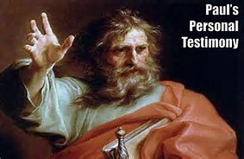
Biblical example
Paul’s testimony
Acts 8-9 (narrative in detail)
Acts 22 (Paul explains story)
  Persecutor of Christians
  Blinded 3 days
  Ananias gives sight back
  Immediate persecution
  Soldier for Christ

Slide 5

My testimony: before Christ
Church on Sundays
Baptized in 5th grade?
10-minute quiet time before day
Lukewarm Christian (not all in)
Good guy but serious struggles inside

Slide 6

My testimony: accepting Christ
Serious depression
  Felt like a failure
  Lower back pain
  Struggles in fatherhood
  Marriage crumbling
  Work was rough
Hospitalized May 7, 2012
Found Jesus that summer

Slide 7
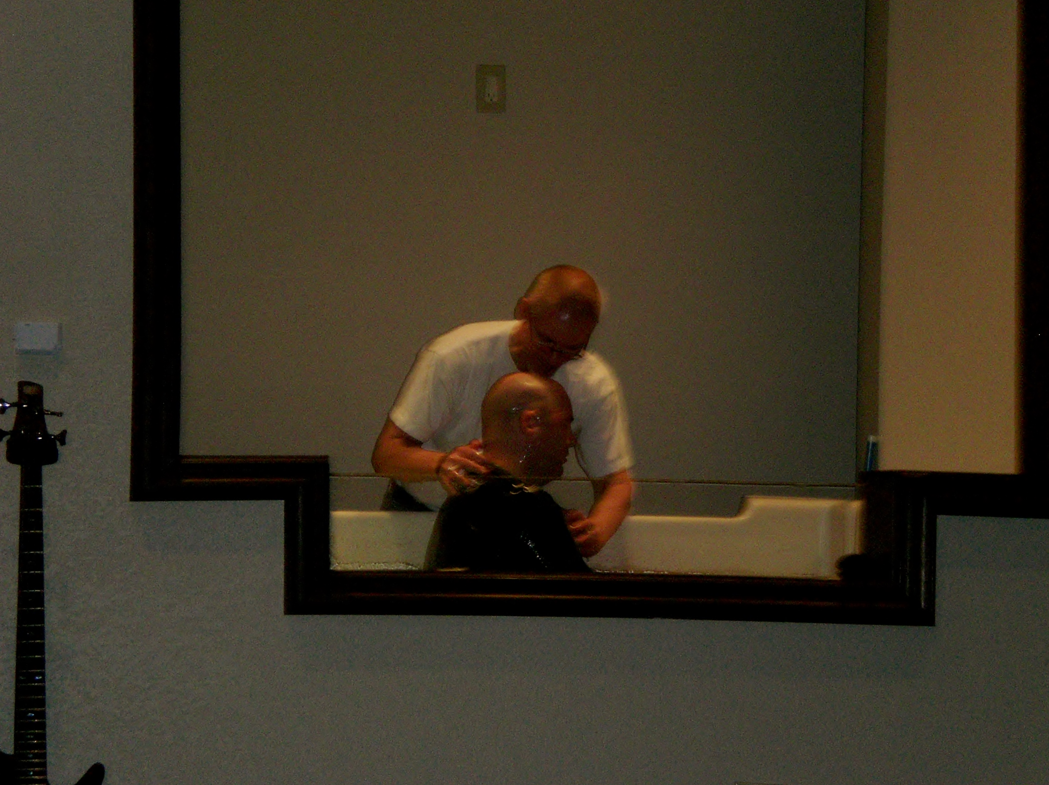
My testimony: Christ in me!
Submission and immediate healing
Baptized February 9, 2013
Quiet time takes off
Accountability/Bible studies
Teacher prayer group
www.theteachersdevotional.com
FCA sponsor since fall 2014
God’s not through with me yet!

Slide 8

Final thoughts
What is God doing in you?
Who needs to hear your story?
How will you share it with them?
The ball is in your court. Go for it!

