Slide 1

Quiet Time
A fun tidbit of information brought to you by fca
Clint Daniels
Indian Trail Middle School
Faculty FCA Sponsor
theteachersdevotional.com
www.theteachersdevotional.com

Slide 2
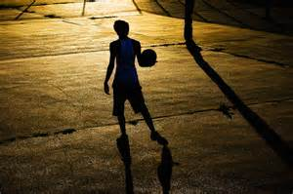
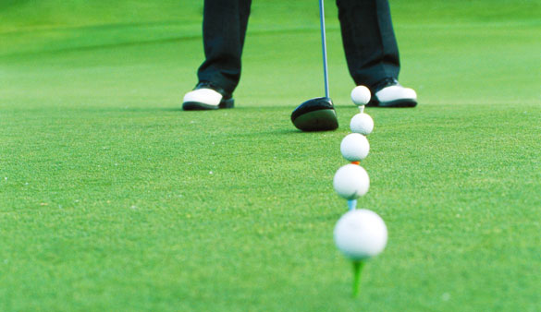
Practice makes perfect
Best athletes train hard
The more you put in, the more you get out!
Olympics = train for four years
Quiet time = “practice” for Christians

Slide 3
What is “Quiet Time?”
Any way you find to further your relationship with God
Not same for all: “There are different kinds of gifts, but the same Spirit distributes them.” (1 Corinthians 12: 4).
“Since we have gifts that differ according to the grace given to us, each of us is to exercise them accordingly … ” (Romans 12: 6).
“Just as a body, though one, has many parts, but all its many parts form one body, so it is with Christ” (1 Corinthians 12: 12).
All different, unique quiet times

Slide 4
How to set it up
Pick a plan (all unique)
Pick a time that works best (preferably at “good time of day” for you)
Pick a place (place you can concentrate)
Commit to your appointment
God = flexible and available 24/7
Start small, but GO BIG!!!
“And He was saying to them all, ‘If anyone wishes to come after Me, he must deny himself, and take up his cross daily and follow Me. For whoever wishes to save his life will lose it, but whoever loses his life for My sake, he is the one who will save it’” (Luke 9: 23 24).
Key word: DAILY

Slide 5
All Quiet Times should involve …
Prayer
“Then you will call upon Me and come and pray to Me, and I will listen to you. You will seek Me and find Me when you search for Me with all your heart” (Jeremiah 29: 12-13).
Bible
“All Scripture is breathed out by God and profitable for teaching, for reproof, for correction, and for training in righteousness, that the man of God may be competent, equipped for every good work” (2 Timothy 3: 16-17).

Slide 6
Prayer
Try ACTS
  Adoration
  Confession
  Thanksgiving
  Supplication
Ask how God can use you
Conversation with God = 2 way
Pause to listen and reflect
“Pray without ceasing” (1 Thessalonians 5: 17).

Slide 7
Bible
Topical search
Beginning to end
Bible studies
Devotions
Memorize scripture
Combine with journaling/reflecting
Watch sermons online

Slide 8

Writing
Journal
Letters to God
Bible study notes/questions
Wisdom for others
E-mail to check in with friends/family
Notes of encouragement/thanks
Poetry/songs
Anything to grow you closer to God

Slide 9
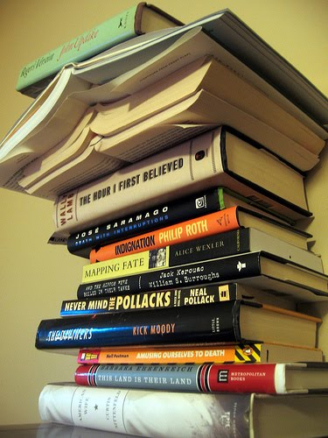
Christian books
Find favorite authors
Find topical studies
Read with friend
Book studies with group
Pass along when done
Swap with others

Slide 10
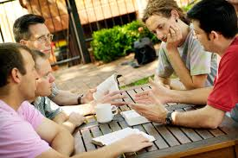
Accountability
Meet with friends, mentors, or mentees
Ask the hard questions
Be real
Grow together
One-on-one or small groups
“Two are better than one because they have a good return for their labor. For if either of them falls, the one will lift up his companion. But woe to the one who falls when there is not another to lift him up” (Ecclesiastes 4: 9-10).

Slide 11
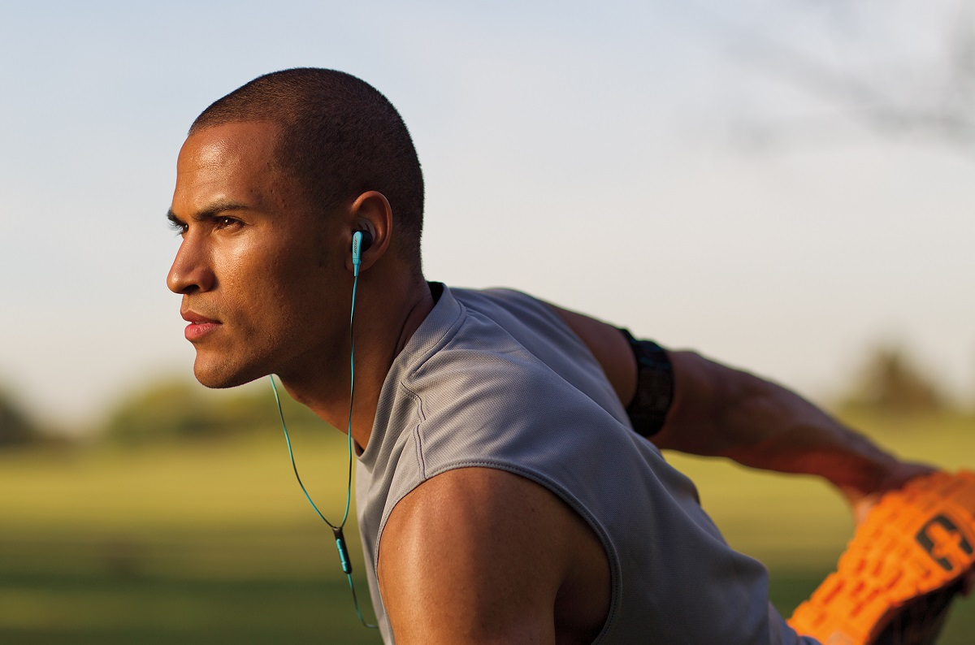
Work out/physical exercise
“Or do you not know that your body is a [a]temple of the Holy Spirit who is in you, whom you have from [b]God, and that you are not your own? For you have been bought with a price: therefore glorify God in your body” (1 Corinthians 6: 19-20).
Strength training, cardio, stretching
Combine with Christian music!!!
Prayer time

Slide 12
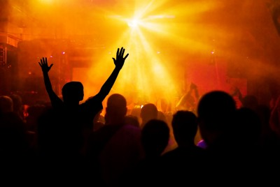
Christian Music
Add to playlist
Create mix tape
Christian radio
Combine with chores
Combine with workouts
Sing!!!

Slide 13

Final thoughts on Quiet Time
Reflect on what works and what doesn’t (chart it)
Try new ideas if you’re in a rut; mix it up!
Chunk quiet time throughout day
New locations (try nature!)
Have others check in on progress
Don’t give up!
“Do not be deceived: God is not mocked, for whatever one sows, that will he also reap” (Galatians 6: 7).

