Slide 1

Perseverance
A word of encouragement brought to you by FCA

Slide 2

Perseverance in athletics
Perseverance is the essence of never quitting and fighting through adversity to achieve a goal.
In sports you will encounter plenty of times when your team is up against all odds.
Have you ever had a star player get hurt?
Have you ever been beaten by a large number of points and have to make a comeback?
You will need perseverance to never quit during these times!

Slide 3

The story of the 2015 chiefs
No team defined perseverance better than the 2015 Kansas City Chiefs.
After their first six games, their team stood at 1-5. They had lost their starting Pro Bowl running back Jamaal Charles for the season, and many people thought their season was over.
Everyone except the Chiefs believed that.
https://www.youtube.com/watch?v=n_qPa_Jo-T4

Slide 4
What does the bible say about perseverance?
“May you be strengthened with all power, according to his glorious might, for all endurance and patience with joy, giving thanks to the Father, who has qualified you to share in the inheritance of the saints in light” (Colossians 1: 11-12).
“More than that, we rejoice in our sufferings, knowing that suffering produces endurance, and endurance produces character, and character produces hope, and hope does not put us to shame, because God's love has been poured into our hearts through the Holy Spirit who has been given to us” (Romans 5: 3-5).
“Count it all joy, my brothers, when you meet trials of various kinds, for you know that the testing of your faith produces steadfastness. And let steadfastness have its full effect, that you may be perfect and complete, lacking in nothing” (James 1: 2-4).

Slide 5
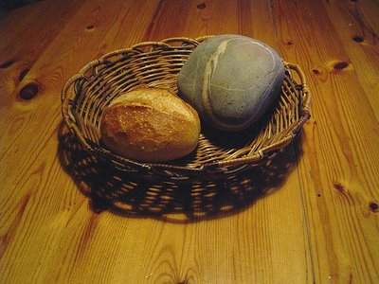
The story of the temptation of Jesus
Jesus had just been baptized by John.
He then went out into the wilderness for 40 days and fasted, not eating anything.
After 40 days, Satan appeared and tempted Jesus.
His first temptation hit Him right where it hurt most: his hunger. Satan told Jesus to make stones become bread, but Jesus stood strong, saying that we do not live on bread alone.

Slide 6
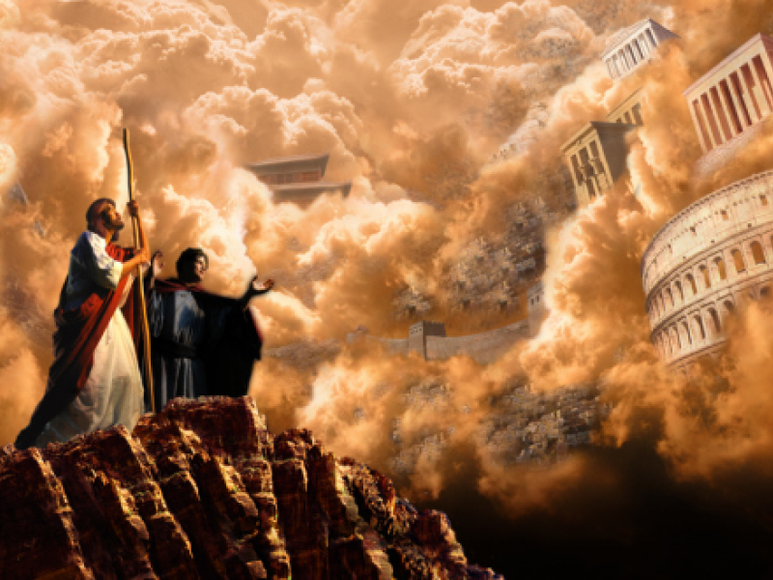
Temptation of Jesus continued …
Satan did not stop there. Jesus’ second temptation came when Satan took Jesus to the top of a temple and told him to jump off, letting His angels catch Him.
Jesus responded with scripture again, saying that we should NEVER put God to the test.
Finally, Satan took Jesus to a hill that overlooked the entire world below Him. He offered Jesus the world if He would bow down and worship the Devil.
Jesus yelled for Satan to leave, saying we should only worship the Lord our God.

Slide 7
Final thoughts on perseverance
We should all strive to have Christ’s perseverance in athletics and in life.
The next time you think about quitting, think again.
The trials we receive in life only make us stronger in the end. Embrace them!
Has there ever been a time in your life when you knew quitting wasn’t an option? How did God pull you through.
Remember Hebrews 12: 1: “Therefore, since we are surrounded by so great a cloud of witnesses, let us lay aside every weight and sin which clings so closely, and let us run with endurance the race that is set before us.”

