Slide 1
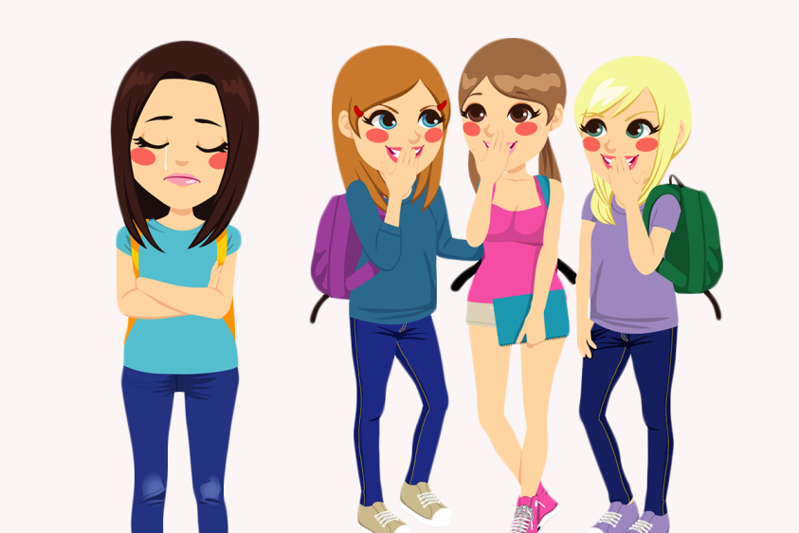
Peer Pressure
A word of encouragement brought to you by FCA

Slide 2
Peer pressure and sports
Peer pressure is any time you feel like you are pressured to do something based on what your friends are doing.
Have you ever been on a sports team where your teammates have made poor decisions that led you to do the same?
Or have you ever made a good choice in sports based on the strong example of your friends? (example: losing graciously, winning humbly, or sticking up for someone)

Slide 3
The story of Len Bias
Len Bias was an amazing basketball player for Maryland. He was drafted by the Boston Celtics and was touted as the next big thing.
https://www.youtube.com/watch?v=uiXvNhXWHOc
Bias hung out with the wrong crowd one night and tried cocaine for the 1st time.
That was all it took to kill him the day after he was drafted by the Celtics.
People still wonder if he would have been the next Michael Jordan.

Slide 4
What does the Bible say about peer pressure?
“Whoever walks with the wise becomes wise, but the companion of fools will suffer harm” (Proverbs 13:20).
“Do not be deceived: Bad company ruins good morals” (1 Corinthians 15: 33).
“My son, if sinners entice you, do not consent” (Proverbs 1: 10).
Which of these verses speaks to you the most? Why?

Slide 5
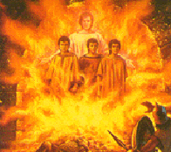
The story of Shadrach, Meschach, and Abednego
Shadrach, Meshach, and Abednego were always loyal to their God.
When a law was passed saying they should bow down to King Nebuchadnezzar, they continued using their strength of friendship to bow down to God, not the king.
This led to the King’s punishment: They had to be thrown into a fiery furnace!

Slide 6
Story continued …
Did you notice something about that picture that popped up? What was behind the men?
That’s right, an angel appeared to keep them from being burned.
King Nebuchadnezzar was so amazed that he decreed a new law: to worship God only.
Shadrach, Meshach, and Abednego did NOT fall into the pressure of worshiping the King. They stayed strong, using their bond and God’s power to overcome the fiery furnace!

Slide 7
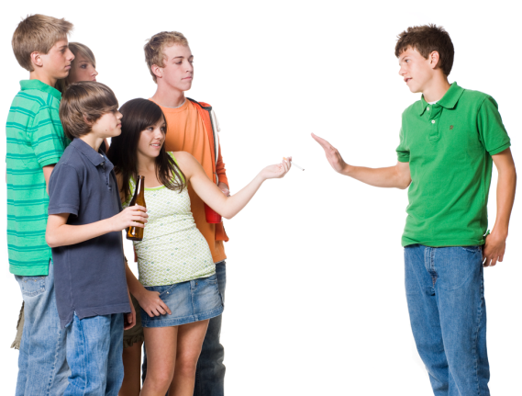
Questions to reflect on …
What areas of your life do you feel pressure to fall into bad influences? (bullying, making fun of others, alcohol/drugs, cheating, looking at inappropriate websites, etc)
Does hanging out with the right friends help you make good choices? How so?
What can we do to overcome peer pressure?
Do you have the strength to say no?

Slide 8
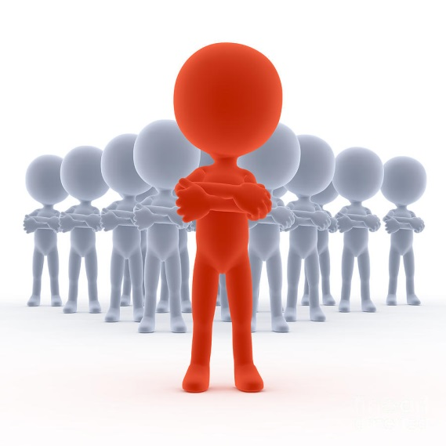
Be a leader!
Be a leader who paves the right path!
Surround yourselves with positive role models. Your friends define your character.
Remember the advice of Mr. Daniels’ Great Grandfather: “It is far better to be alone than in bad company” (Everette Van Velzer).

