Slide 1
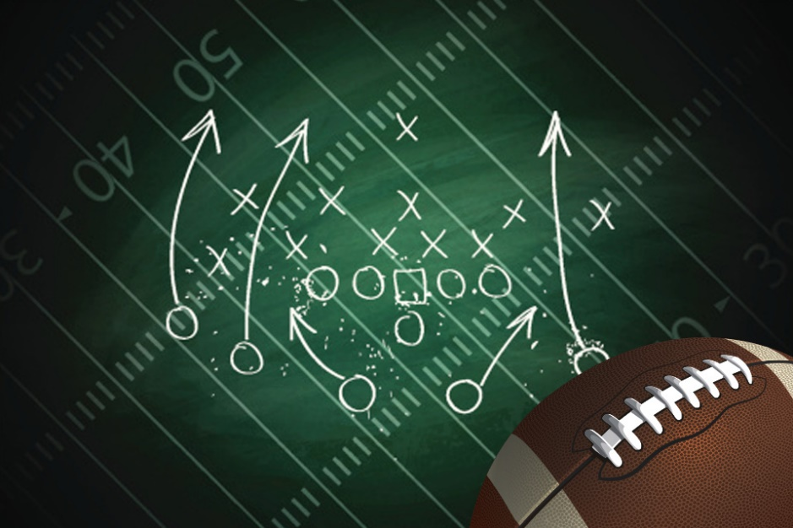
Know Your Playbook!
A word of encouragement brought to you by fca

Slide 2
My life playing football
8th grade and 9th grade: offensive lineman???
10th grade through 12th grade: receiver
Riding the bench
Going out with a bang!

Slide 3
The Christian Students’ Playbook
You can pray, read your Bible or other religious material, and talk about your faith at school.
You can organize prayer groups and religious clubs, and announce your meetings.
You can express your faith in your class work and homework.
Your teachers can organize prayer groups with other teachers.

Slide 4
Christian Students’ Playbook cont …
You may be able to go off campus to have religious studies during school hours.
You can express your faith at a school event.
You can express your faith at your graduation ceremony.

Slide 5
Tyler’s Story
Began a Bible Study in my class on Monday mornings
Became the first FCA leader at Indian Trail Middle School
Recently baptized and living life for Christ at next level

Slide 6
A Happy Ending: the Catch
Last football game against brother Clay
Clay = All EVERYTHING!
Me = bench warmer
The greatest play you’ve never heard of

Slide 7
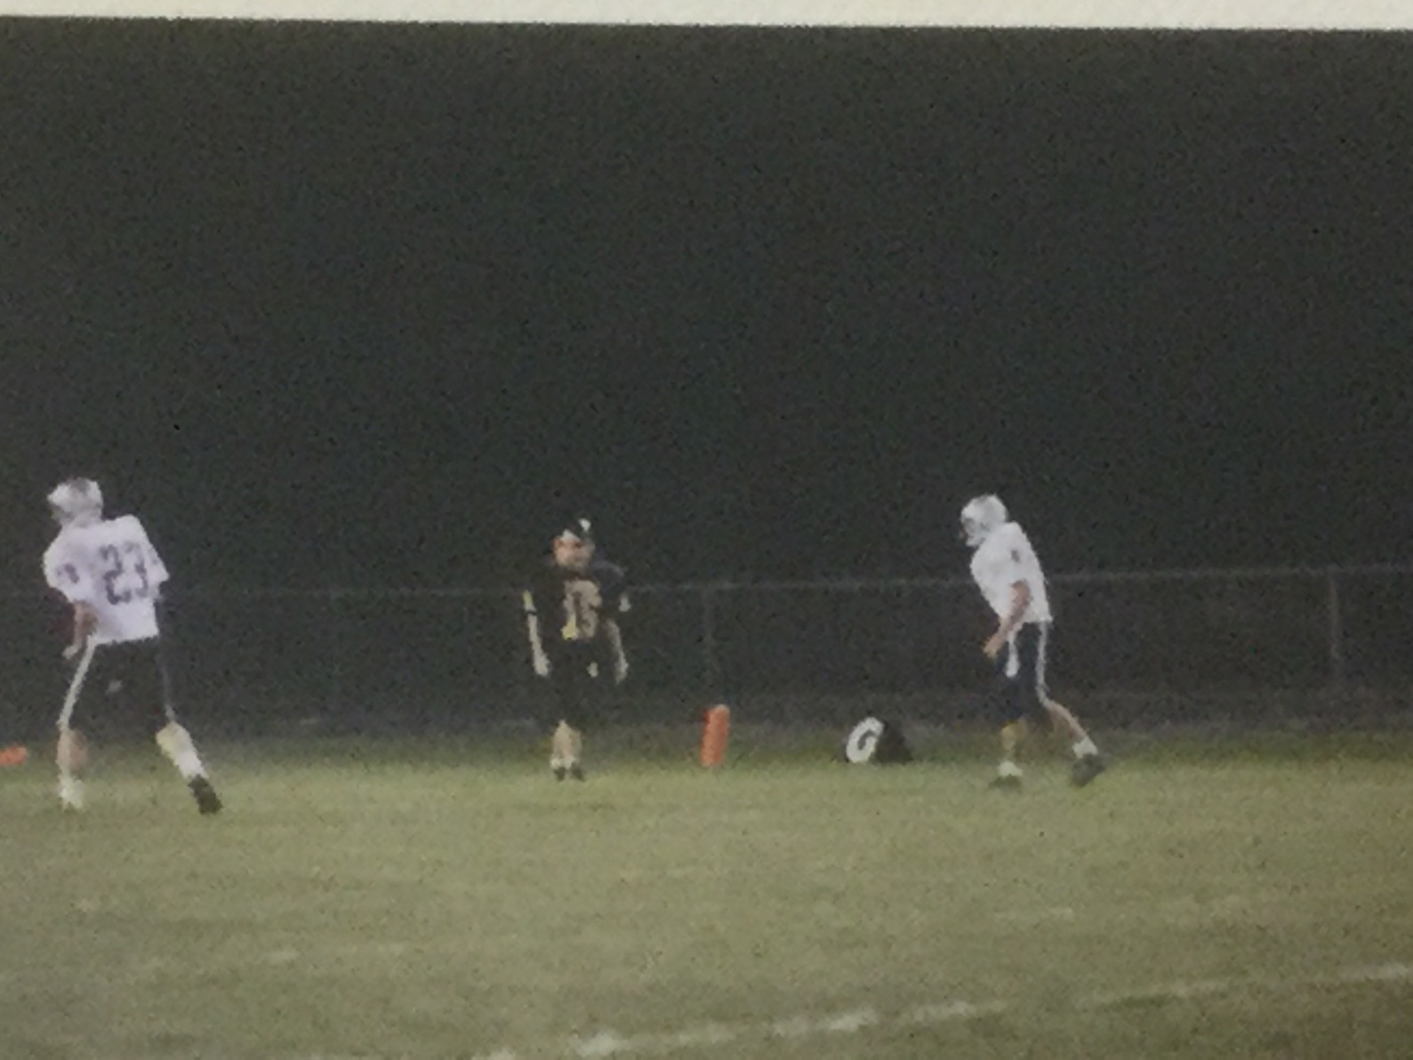
Lining up, brother vs. brother

Slide 8
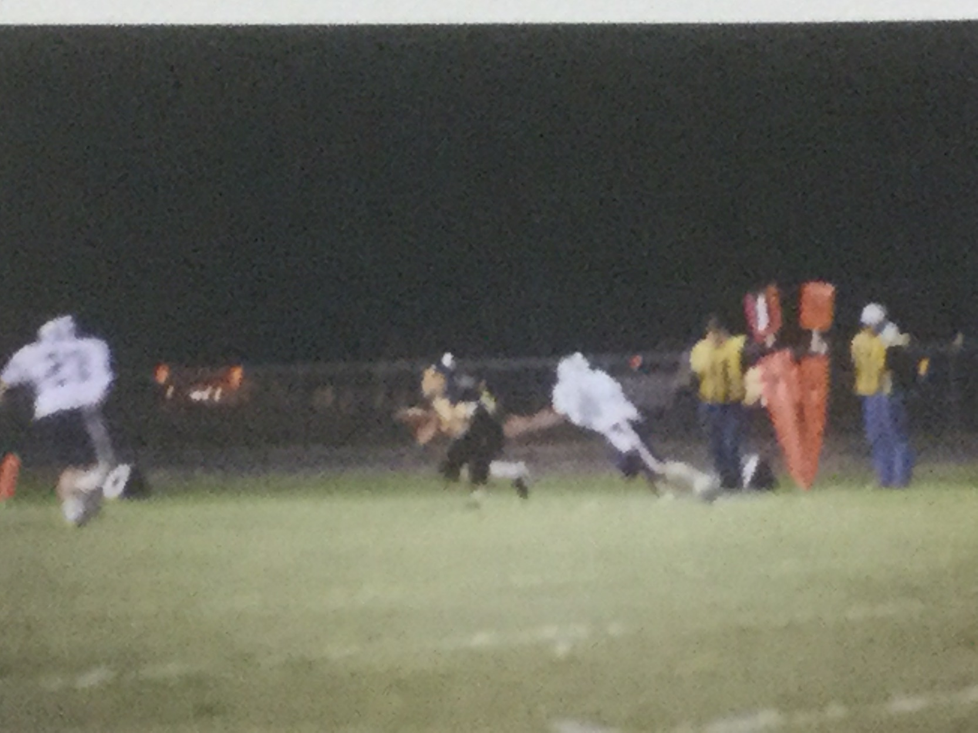
The catch!

Slide 9
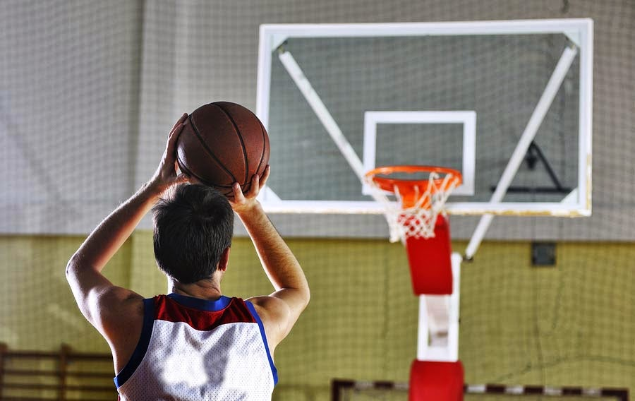
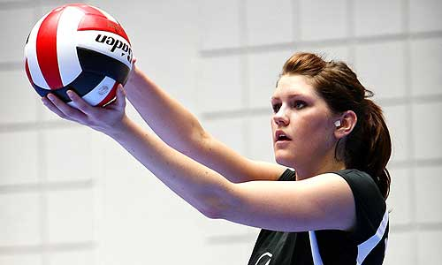
What will you do?
Inviting friends to FCA
Organizing fellowships
Talking to sports friends about faith
Starting a Bible study
Talking in class about Jesus
The ball is in your hands!

Slide 10
My information
Clint Daniels
Indian Trail Middle School
Faculty FCA sponsor
theteachersdevotional@gmail.com
www.theteachersdevotional.com

