Slide 1

Keeping the Christ in Christmas
A word of encouragement brought to you by FCA

Slide 2
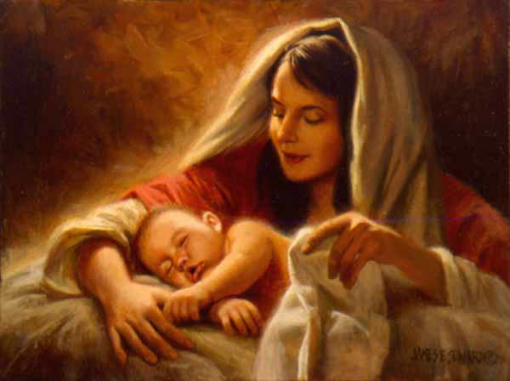
What do you think of when the word Christmas comes to mind?
A Christmas tree?
Christmas lights?
Santa?
Presents?
Tons of food and sweets?
Snow?
Egg nog?
Or do you think about the true meaning of Christmas: the birth of Christ?

Slide 3

Before we go any further, let’s hear a quick message from Derwin Gray, the Christmas linebacker
You may remember Derwin from such videos as the Evangelism Linebacker.
Now he is on a mission to knock some sense into those who refuse to keep the Christ in Christmas.
Check out his video here: https://www.youtube.com/watch?v=wGtrzQx0M8M

Slide 4
Here are some ideas to keep the Christ in Christmas …
Have your family read the story of the birth of Jesus on Christmas Eve from the Bible as opposed to reading the Night Before Christmas.
Make birthday cupcakes or a birthday cake for Jesus on Christmas Day, and sing happy birthday to Him!
Sing Christmas carols that celebrate the birth of Christ like We Three Kings, the First Noel, or Away in the Manger.
Give a faith gift to someone you love. This could be anything from a devotional to a Bible to Christian apparel. Anything that promotes faith is fair game!
Set up a nativity scene in your home.
Send Christmas cards with a spiritual message.
Participate in a service project of some kind (soup kitchen, volunteer work, etc)
Do you have any ideas that your family does? If so, feel free to share them now!

Slide 5

Some final thoughts about keeping the Christ in christmas
https://www.youtube.com/watch?v=lbEhS0G2_uA
Now that you have been presented with all these ideas, which ideas do you want to incorporate in your family?
What will you go home and share with your parents?
Keep the Christ in Christmas this year!

