Slide 1

God’s Grace
A word of encouragement brought to you by FCA

Slide 2
The importance of grace
Have you ever messed up in life?
When you did something wrong, did you feel any guilt afterwards?
How did it make others feel?
The truth is that we are all sinners. Romans 3: 23 states, “For all have sinned and fall short of the glory of God.”
That is why we are all in desperate need of God’s grace.

Slide 3

What is grace?
Grace is given to us by God if we confess our wrongs to Him.
We don’t deserve it, but it is God’s free gift to us!
Isaiah 1: 18 states, "Come now, let us settle the matter," says the Lord. "Though your sins are like scarlet, they shall be as white as snow; though they are red as crimson, they shall be like wool.”
God’s grace covers every sin, no matter how awful the crime.

Slide 4
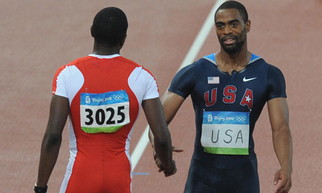
Grace in sports
You will need grace on both sides here. You will wrong others, and others will wrong you.
If you lose your temper and throw a punch at an opposing player, you are in need of grace.
If someone wrongs you, as a Christian athlete you are called to give grace.
No matter who messes up, God’s grace covers it all. No questions asked.

Slide 5
The conversion of Paul
Paul was known as one of the worst persecutors of the early Christian church.
He was responsible for the stoning of Steven in Acts chapter 7.
Paul was asked by Jesus why he was persecuting Him, and he was blinded for three days.
Paul’s eyes were then opened and he became one of the most famous Christians ever.
https://www.youtube.com/watch?v=bN4tqrCgWwc

Slide 6
The power of grace
Even Paul’s crime of murdering Christians was not awful enough to be cleansed by God’s grace.
When we mess up in life, we must humble ourselves before God and ask His forgiveness.
God’s grace will wash all our sin whiter than snow.
Listen to Matthew West’s song “Grace Wins.”
https://www.youtube.com/watch?v=9JXl1czvh7g

