Slide 1

God Works Everything For Our Good
A word of encouragement brought to you by fca
Clint Daniels
Indian Trail Middle School
Faculty FCA Sponsor
www.theteachersdevotional.com

Slide 2
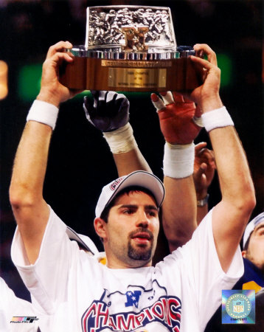
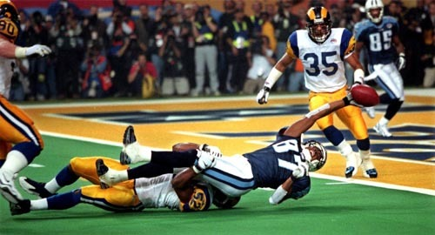
1999 St. Louis Rams
Starting QB Trent Green out for season (injured in preseason game)
Doubts from the media about Kurt Warner
Rams go 13-3 and win the Super Bowl
Kurt Warner = MVP of NFL and Super Bowl XXXIV

Slide 3
Romans 8:28
“And we know that God causes everything to work together for the good of those who love God and are called according to his purpose for them.”
Two main parts to remember:
  Everything works for the good
  Only for those who love God and who are called according to His purpose
Must see the positive, eternal perspective
“And now, dear brothers and sisters, one final thing. Fix your thoughts on what is true, and honorable, and right, and pure, and lovely, and admirable. Think about things that are excellent and worthy of praise” (Philippians 4:8).

Slide 4
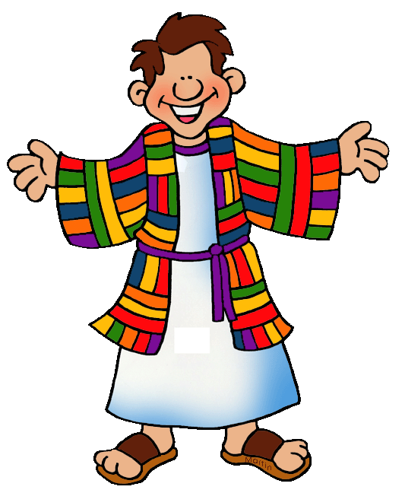
The story of Joseph
Joseph favored by his dad
Jealous brothers sold Joseph to slavery
Sold to Potiphar and put in charge
Potiphar’s wife lies about Joseph
Joseph thrown into prison

Slide 5
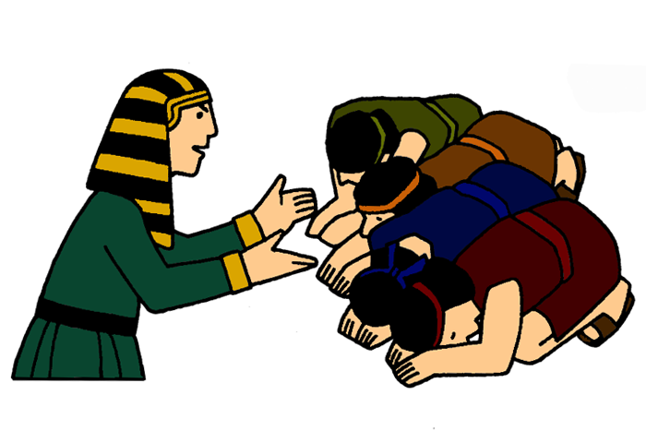
The story of Joseph continued …
Joseph interprets Pharaoh’s dream
7 years of prosperity; 7 years of famine
Joseph put in charge
Joseph’s brothers return
“But Joseph said to them, “Do not be afraid, for am I in God’s place? As for you, you meant evil against me, but God meant it for good in order to bring about [a]this present result, to preserve many people alive” (Genesis 50: 19-20).

Slide 6
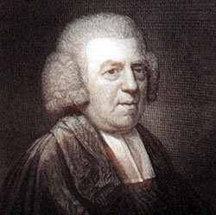
Testimony: John Newton (1705-1827)
Grew up on sea with father
Deserted ship and flogged (1744)
Worked on slave ship (1748)
Violent storm prayer; conversion (May 10, 1748)
Began to treat slaves humanely
Gave up job to become a minister
Wrote song “Amazing Grace” (1760-1770)
http://www.anointedlinks.com/amazing_grace.html

Slide 7
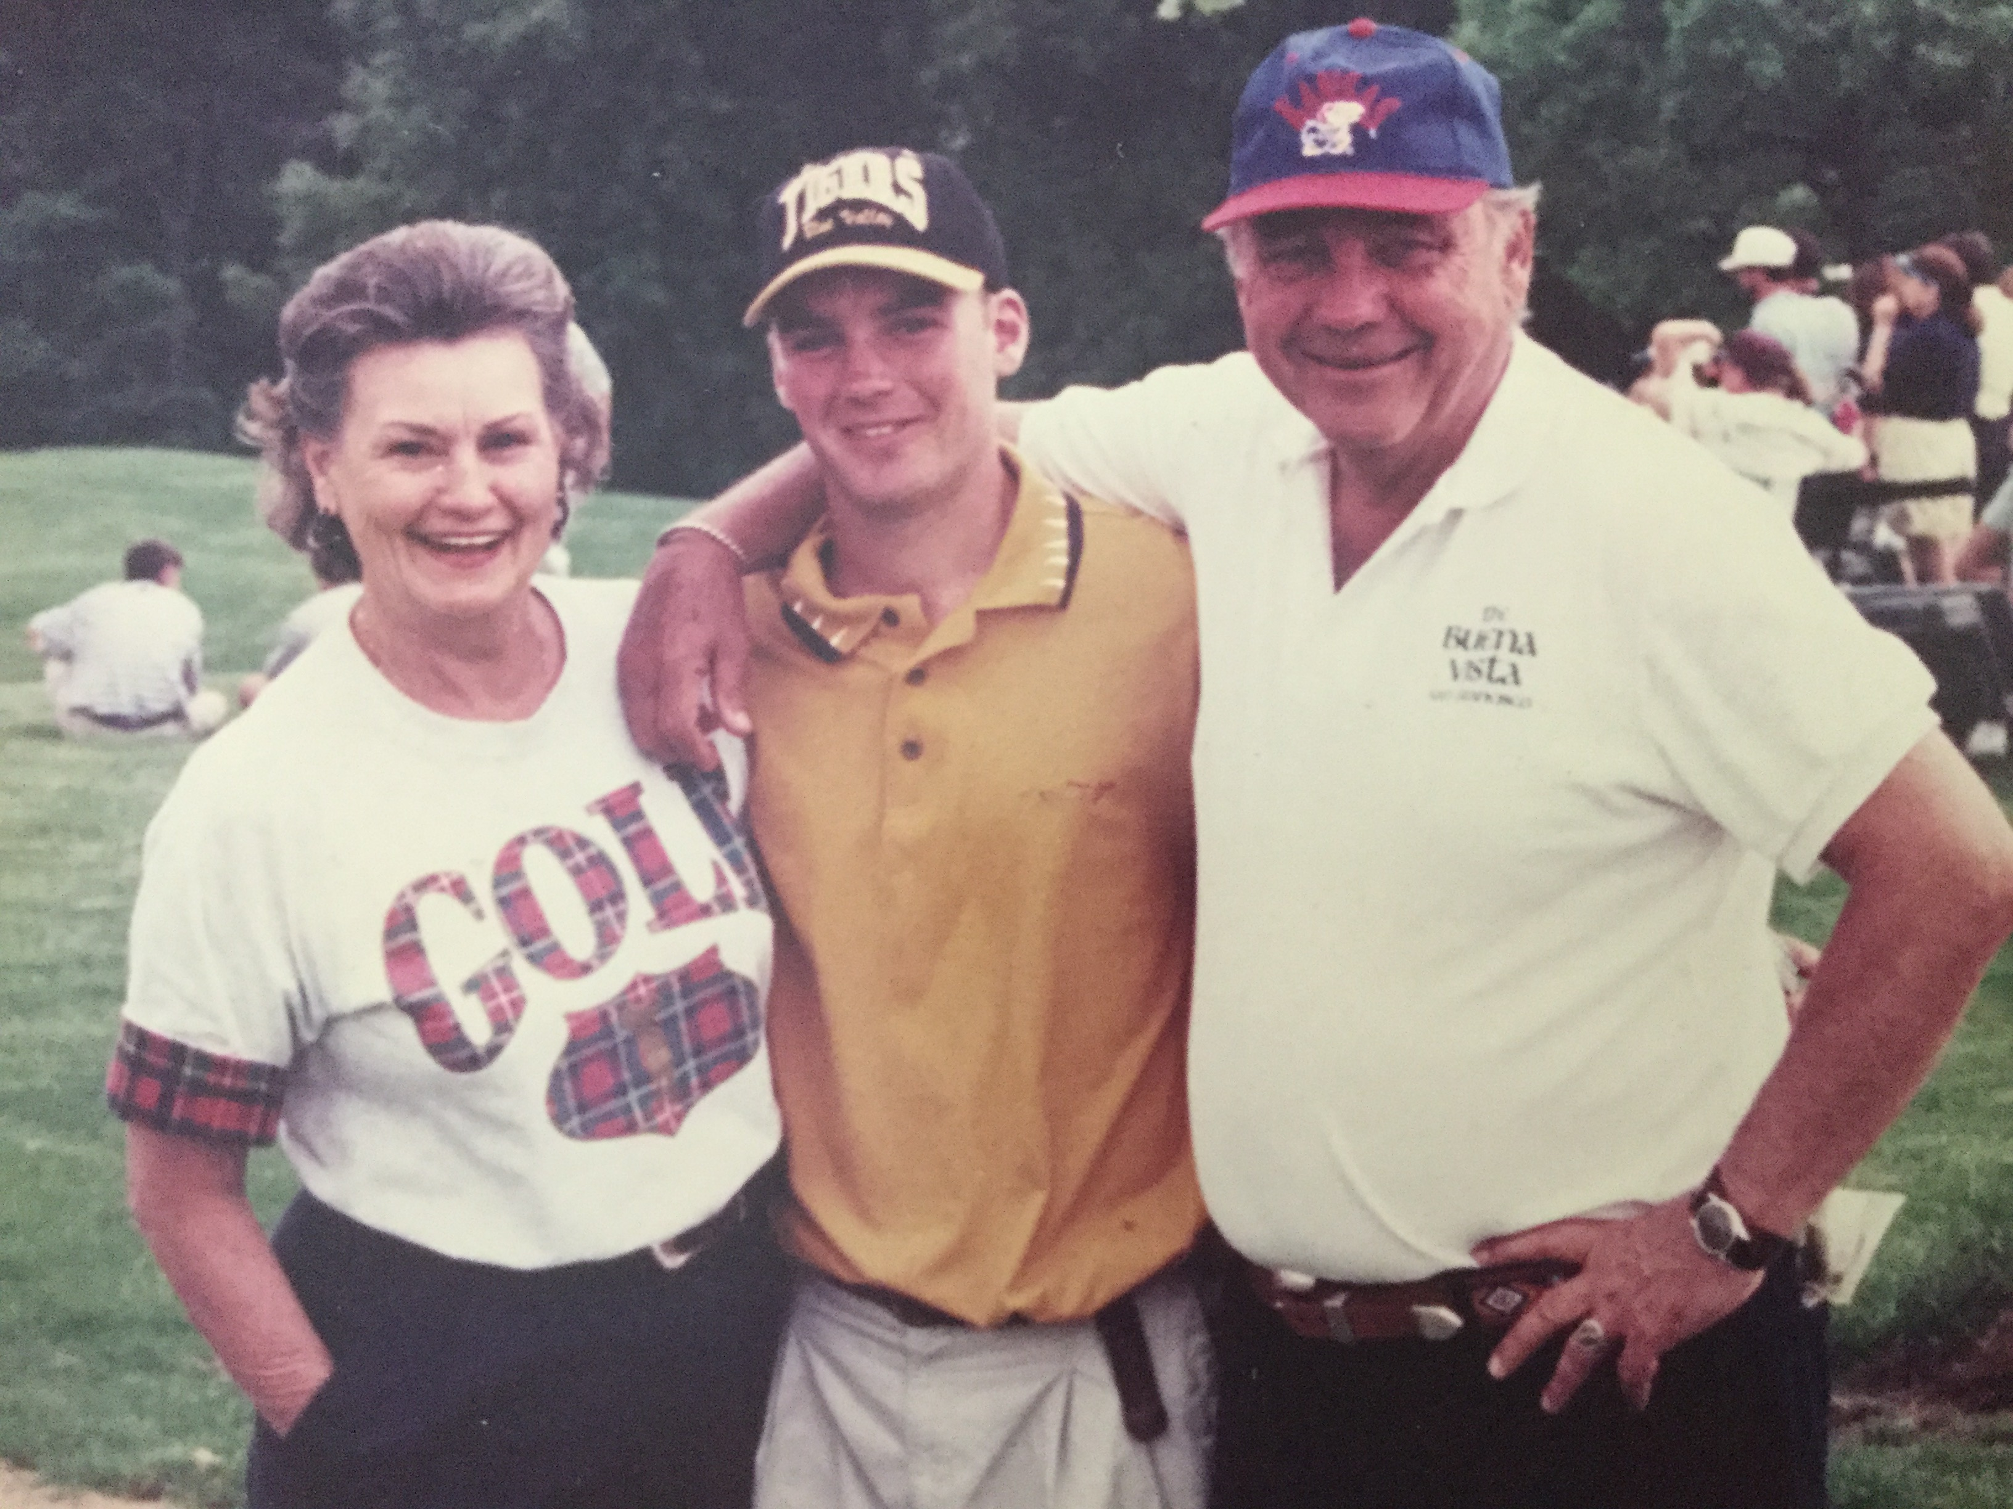
Reflection questions
Which one of the stories heard today hits home the most with you? Why?
How has God worked something that might be considered bad for the good for you?
What is something good that can come out of a problem you are facing right now?

Slide 8
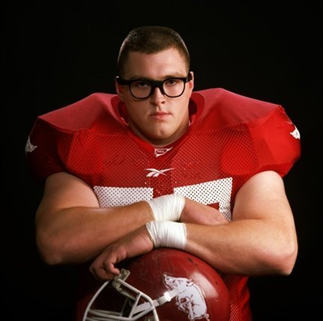
Fellowship idea
Greater (story of Brandon Burlsworth)
Incredible testimony how God works bad for good!
Blog post: https://theteachersdevotional.com/2017/07/03/why-do-bad-things-happen-to-good-people/

