Slide 1

Giving Thanks
A word of encouragement brought to you by FCA

Slide 2
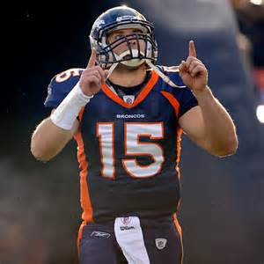
How would you answer the following questions?
How often do you praise God?
Do you give thanks no matter what the circumstance, or do you give thanks only when things are going well?
Have you ever had something bad happen to you but in the end something good was born from the bad? What happened?
How can we praise God always, even when things are going wrong?
Tim Tebow

Slide 3

Facing the Giants
In the movie Facing the Giants, a football team has come to a crossroads in their season.
Their coach has just learned that Christ needs to be first in the life of the team, and he challenges his players to praise God no matter what the circumstance.
See the clip from the movie here: https://www.youtube.com/watch?v=AYQ3eV6rR_Y

Slide 4
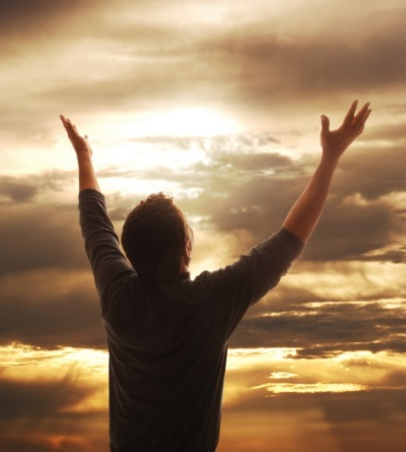
What does the Bible say about giving thanks?
“Rejoice always, pray without ceasing, in everything give thanks. For this is God’s will for you in Christ Jesus” (1 Thessalonians 5: 16-18).
“Oh give thanks to the Lord, for he is good, for his steadfast love endures forever” (Psalm 107: 1).
“I am content with weaknesses, insults, hardships, persecutions, and difficulties for Christ’s sake. For when I am weak, then I am strong” (2 Corinthians 12: 10).
Which scripture speaks most to you? Why?

Slide 5
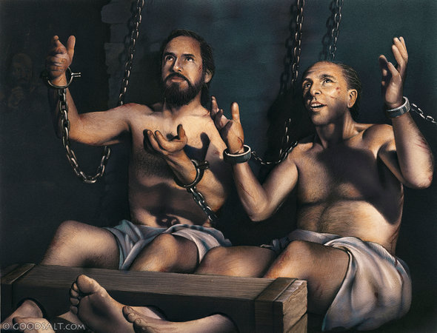
The Story of Paul and Silas
Paul and Silas were thrown into jail for witnessing to others.
You would think that being thrown into jail would make them sad, but it actually had the opposite effect.
Paul and Silas praised God and sang songs to Him while they were in chains.
There was a violent earthquake, and the jailer thought all the prisoners had escaped, but they hadn’t.
Paul and Silas stopped the jailer from taking his life and witnessed to him.
Here is their story: https://www.youtube.com/watch?v=Z7qcHEDjk6w

Slide 6
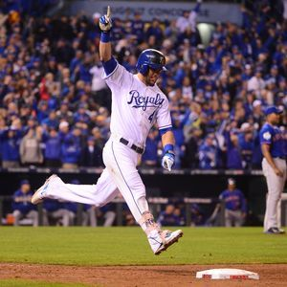
Main points about giving thanks …
God wants us to praise Him no matter what the circumstance.
God wants us to realize that good can indeed come out of bad.
God wants us to appreciate what He blesses us with.

Slide 7
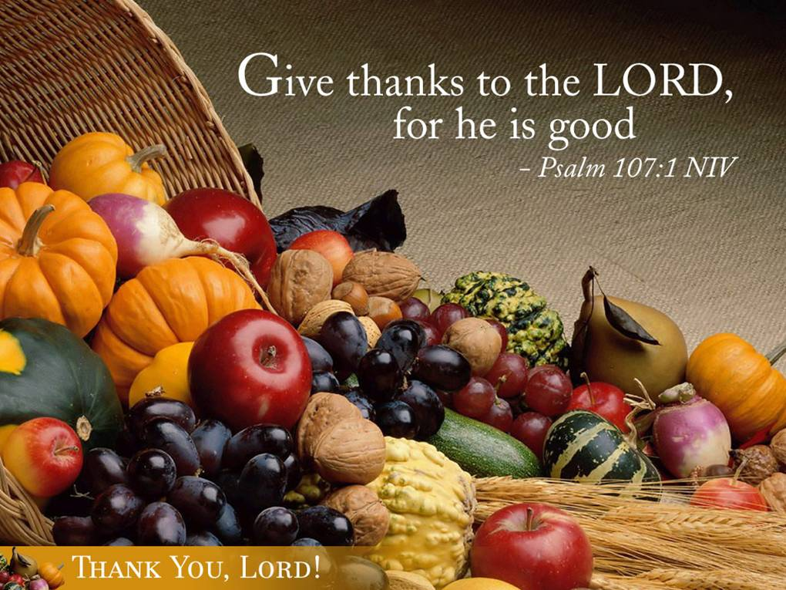
As you prepare for Thanksgiving …
What are the things in life you are thankful for?
Find someone you think deserves thanks and let them know about it in a creative way!
  Letter
  Card
  Poem
  Encourage with scripture
  Song
  Small gift

