Slide 1

Forgiveness
An encouraging message brought to you by Fca

Slide 2
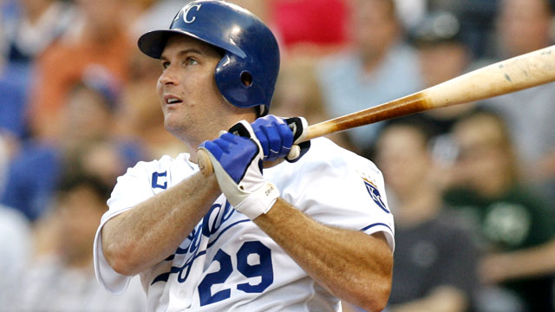
Mike Sweeney’s story is one of faith and forgiveness.
Mike Sweeney was a Kansas City Royals baseball player for a long part of his major league career.
Sweeney was largely considered one of the nicest players in baseball, always living out his faith on the field.
He was not perfect by any means, but his faith in Christ pulled him through the hard times.
Here is his story: https://www.youtube.com/watch?v=Eih4rqhy1p4.

Slide 3
What does the Bible say about forgiveness?
“Be kind to one another, forgiving one another, as God in Christ forgave you” (Ephesians 4:32).
“Then Peter came up and said to him, ‘Lord, how often will my brother sin against me, and I forgive him? As many as seven times?’ Jesus said to him, ‘I do not say to you seven times, but seventy times seven’” (Matthew 18: 21-22).
“Jesus said, ‘Father, forgive them, for they do not know what they are doing’” (Luke 23: 34).

Slide 4

The story of Jesus on the cross
The Roman soldiers treated Jesus ruthlessly.
They began by scourging Him, beating Him over and over again.
They put a crown of thorns on His head and mocked Him.
They nailed Him to the cross and insulted Him from below.
Jesus still found it in His heart to ask God to forgive them.

Slide 5
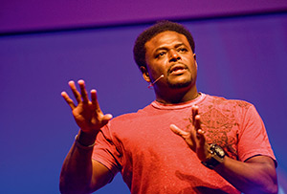
Derwin Gray chose to forgive his father for abandoning him.
Derwin’s dad had never seen him play a single football game in his entire life, and Derwin had made it all the way to the NFL.
At first, Derwin did not want any part of his father.
But his heart told him that Jesus wanted him to forgive his father.
Here is his story: https://www.youtube.com/watch?v=H8Z0TGHJp3I.

Slide 6

Questions to think about …
Why is it so hard to forgive others for wronging us?
Have you ever messed up in life and needed forgiveness from someone else?
Who do you need to forgive in your life?

