Slide 1
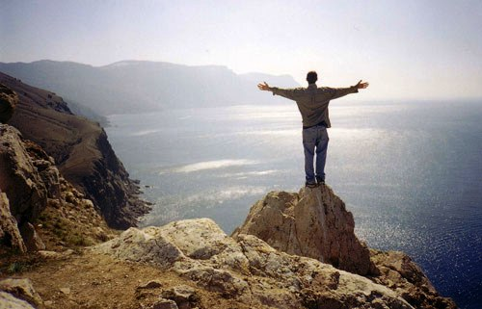
Embracing Life!
A word of encouragement brought to you by FCA

Slide 2
What is the difference between self-harm and suicide?
Self harm is defined as “the intentional, direct injuring of body tissue most often done without suicidal intentions.”
Examples of self-harm would be intentionally cutting, burning, hitting, or banging body parts.
Suicide is when one attempts to take his or her own life.
If you or someone you know are experiencing any of these temptations, seek help immediately.

Slide 3

The story of Jovon Belcher
Jovan Belcher was an upcoming linebacker for the Kansas City Chiefs.
Belcher committed suicide in December 2012, putting a gun to his head and pulling the trigger.
https://www.youtube.com/watch?v=lr8_vU00bXM

Slide 4
What does the Bible say about self-harm and suicide?
“For we are God’s masterpiece. He created us anew in Christ Jesus so we can do the good things he planned for us long ago” (Ephesians 2: 10).
“Be not overly wicked, neither be a fool. Why should you die before your time?” (Ecclesiastes 7: 17)
“For I know the plans I have for you declares the Lord, plans for good and not for evil, to give you a future and a hope” (Jeremiah 29: 11).
“The Lord has made everything for its purpose, even the wicked for the day of trouble” (Proverbs 16: 4).
Which scripture above speaks to you the most?
Which one do you think would help someone the most with suicidal or self-harming thoughts?

Slide 5
The story of Paul and Silas saving the jailer
Paul and Silas were thrown in jail for preaching about Jesus. Shackled in chains, they actually chose to celebrate and praise God with hymns.
God heard their praises and suddenly a violent earthquake shook the grounds.
Their jailer awoke finding the doors opened. He knew his only job was to keep the prisoners from escaping, and he thought he had breeched this responsibility
He was ready to take his own life, knowing that he would surely be fired for letting all the prisoners go.

Slide 6
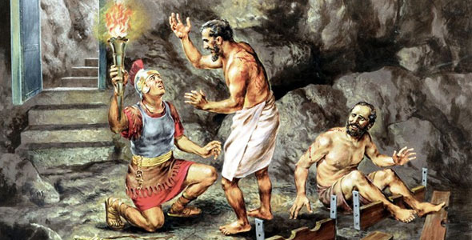
Paul and Silas’ story continued …
Paul and Silas immediately stopped the jailer from harming himself.
They assured him that all the prisoners were still there and likewise told him about Jesus.
The jailer asked what he could do to be saved, and Paul and Silas told him to believe in Jesus.
The jailer was soon baptized as a new Christian, and he got his entire family to be baptized as well—all because two men reached out to him.

Slide 7
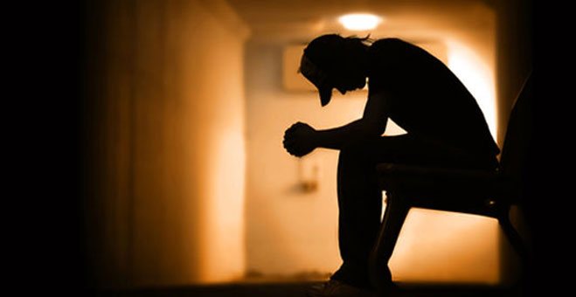
What to look for …
People who self-harm or who are considering suicide as a way out typically experience any of the following symptoms. Be on the lookout for people who:
Isolate themselves from family and friends.
Cry easily.
Talk about death a lot.
Seem to feel hopeless.
Lose interest in things they typically care about.
Display mood swings.

Slide 8

Final thoughts on self-harm and suicide
If you know of anyone who is experiencing these thoughts, immediately refer them to a counselor or trusted adult.
God has blessed us all with life. We all have a purpose. We are all “beautifully and wonderfully made” (Psalm 139: 14).
If you are feeling any of the above feelings, know that whatever is going on in your life, it is not too big for God to conquer. These thoughts are NOT normal. Seek help!
If you doubt that power, remember Philippians 4: 13 when Paul states, “I can do all things through Christ who gives me strength.”

