Slide 1
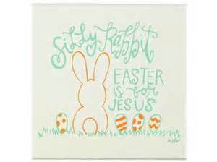
Embracing Easter
A word of encouragement brought to you by FCA

Slide 2
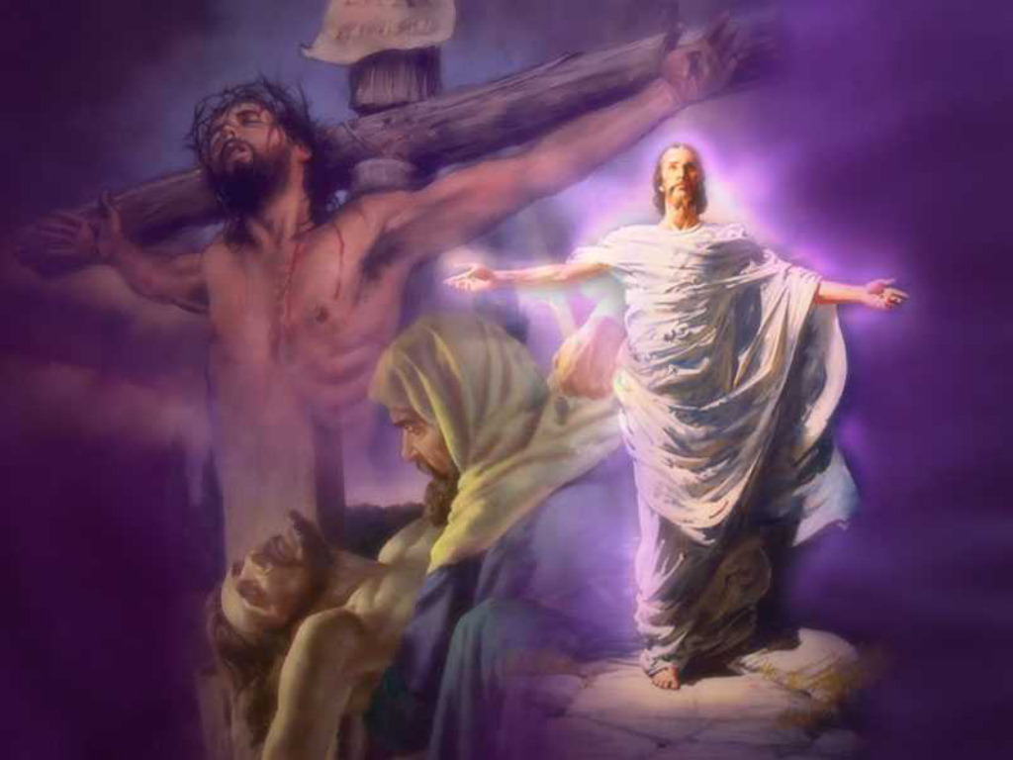
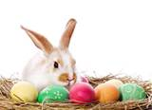
What image below comes to mind when you think of Easter?
A bunny and some eggs?
Or the resurrection of Jesus Christ?
As the Super Bowl is sometimes known more for its commercials or the halftime show, the celebration of the true meaning of Easter is at times drowned out by egg hunts, chocolate bunnies, and Easter baskets.

Slide 3
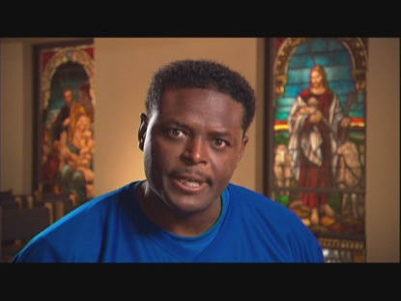
A message from Derwin Gray, the Easter Linebacker.
You may remember derwin from such videos as the Christmas linebacker and the evangelist linebacker.
Well the former Indianapolis colts safety is at It again. This time he is making his debut as the easter linebacker. Look Out!
https://www.youtube.com/watch?v=BgNZ7RmNBX8
You may remember derwin from such videos as the Christmas linebacker and the evangelist linebacker.
Well the former Indianapolis colts safety is at It again. This time he is making his debut as the easter linebacker.
https://www.youtube.com/watch?v=BgNZ7RmNBX8

Slide 4
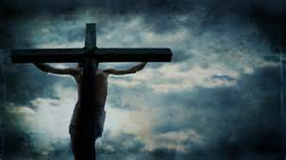
What is Easter all about?
Is it about an egg hunt, or is it about Jesus dying for our sins?
Is it about a silly bunny, or is it about Jesus conquering the grave?
Is it about an all-you-can eat buffet with your family, or is it about the core of our religion, knowing that what jesus did on that Friday afternoon changed our lives—forever?
It isn’t that celebrating with an egg hunt is wrong. It is wrong, however, if you chose not to reflect on the true meaning of Easter.

Slide 5
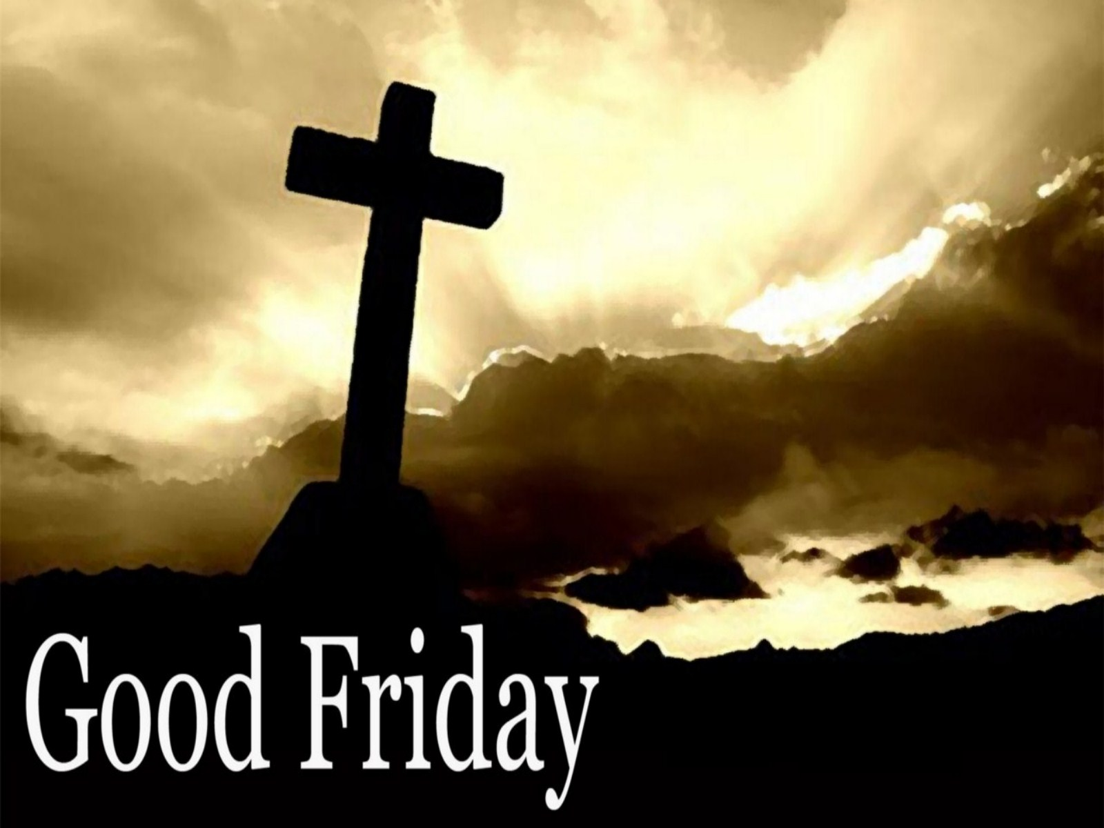
Why do they call it good Friday?
The Friday Jesus died is called good Friday. What is so good about jesus dying?
The truth is simple: Jesus died on that day to take the punishment of our sin.
Every time we mess up in life, so long as we confess our sin to god and repent, jesus takes the blow for us.
Look at it like this … you are on earth, and you mess up. God sends down his punishment upon you, but right in the middle there is Jesus, taking that punishment for you.
This is not just a good thing. It is a great thing! Hence the name good Friday.

Slide 6
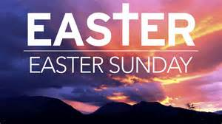
Easter sunday
The Sunday following chirst’s death on the cross, a miracle happened.
Roman soldiers guarded the grave where Jesus was buried. A stone was rolled in front to secure it.
When mary Magdalene and the other mary came to look at the grave, a violent earthquake shook the ground and an angel stood before them.
The angel told them that Jesus had risen from the grave. Death was conquered!
Jesus appeared to his disciples and encouraged them to make disciples of all nations, baptizing them in the name of the father, son, and holy spirit.

Slide 7
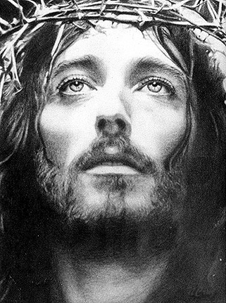
Final thoughts on easter
You can celebrate easter with an egg hunt, family, and even a goofy bunny. Just be sure to thank god for jesus, go to church, and celebrate the true meaning of easter: the death and resurrection of Jesus.
Here is a powerful video that celebrates the sadness of Jesus’ death but promises the defeat of death in Christ’s resurrection on Sunday. Sunday is a coming!
https://www.youtube.com/watch?v=YByT6wfdhJs

