Slide 1
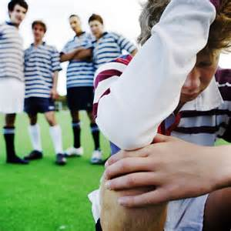
Bullying
An encouraging word brought to you by FCA

Slide 2

Bullying and Athletics
Have you ever seen bullying in sports? What happened? How did you respond?
Has anyone on an opposing team ever taunted you or one of your teammates?
Have you ever had to do something for your team just since you were the new kid?
Have you ever had to stand up for a teammate who was being bullied?
How would God want you to respond if you were being bullied?

Slide 3
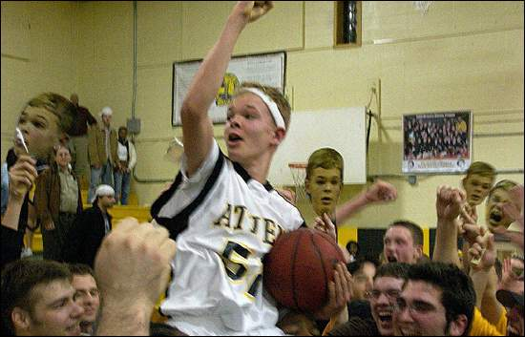
How have athletes done the right thing through the years?
Check out the videos from the following stories:
https://www.youtube.com/watch?v=y29VCO_CdH8
What was the most inspiring story? Why?
What did all these athletes have in common?
Jason McElwain

Slide 4

What does the Bible say about bullying?
“You shall not take vengeance or bear a grudge against the sons of your own people, but you shall love your neighbor as yourself: I am the Lord” (Leviticus 19:18).
“For God gave us a spirit not of fear but of power and love and self-control” (2 Timothy 1: 7).
“You have heard that it was said, ‘You shall love your neighbor and hate your enemy.’ 44 But I say to you, Love your enemies and pray for those who persecute you,’” (Matthew 5: 43-44).
Which of the above scriptures in the most impactful for you? Why is that so?

Slide 5
A final word about bullying from MercyMe and their song “Greater”
https://www.youtube.com/watch?v=3Kpc_lb2HH8
When others get the best of you through words of hate, know that they are not the enemy. Satan is the enemy.
Satan is taking shots at you because he knows you’re something special.
The end all truth, however, is that the power of Christ is greater than Satan.
Know that God will pull you through! He is greater!

Slide 6

Main Points About Bullying
God never tells us to take revenge.
Conduct yourself with self-control on the field of play.
Build up and encourage your teammates. Never tear them down.
Stick up for what you know is right—even if your friends are making poor choices.
Love one another. You can never go wrong with kindness and love.

