Slide 1

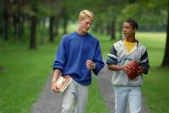
Accountability
Information inspired by Dan Britton and Jimmy Page
(Wisdom Walks Sports)

Slide 2
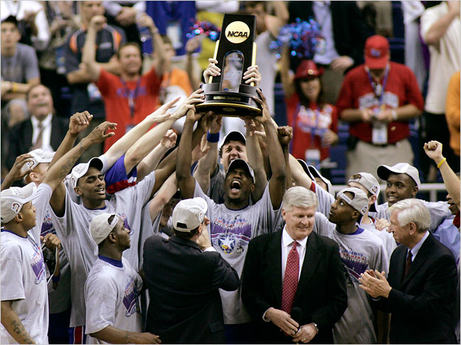
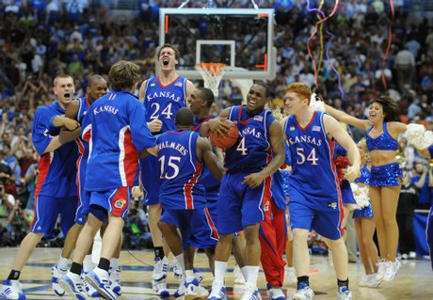
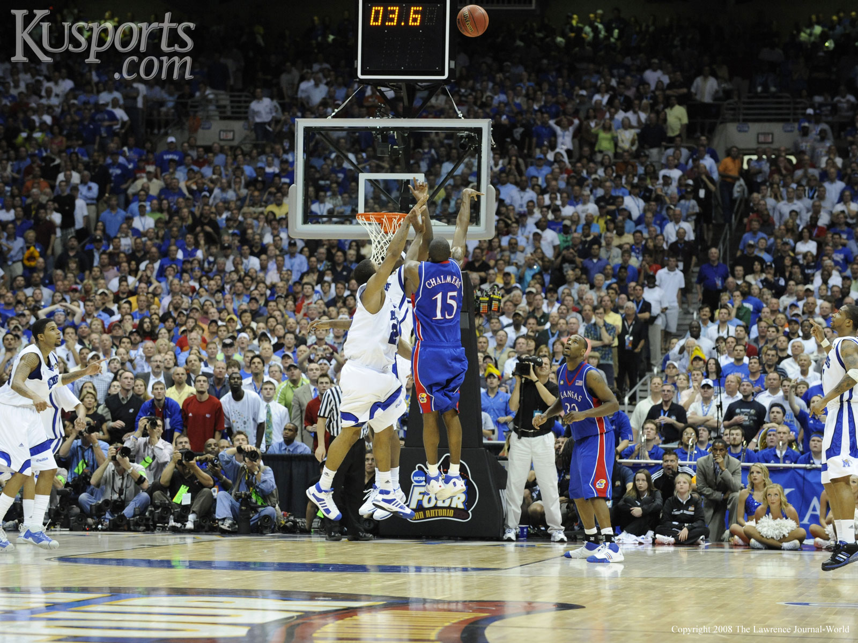
Best Sports Team Ever?
What team did you pick?
Why did you pick that team?
What separated that team from the rest?

Slide 3
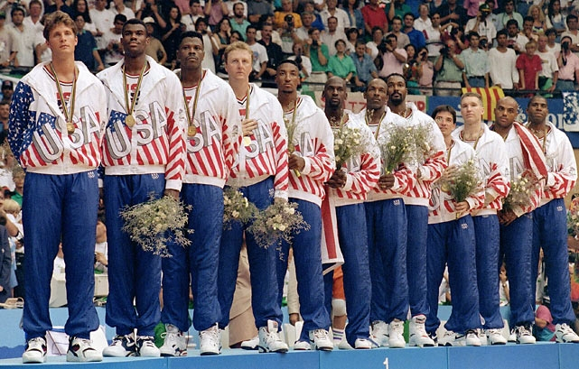
Your Accountability Team = Dream Team
You = the Watcher
Friends = Warriors
Mentor = Watchman
Mentee = Workman
Watchman
Warrior
Watcher
Warrior
Workman

Slide 4

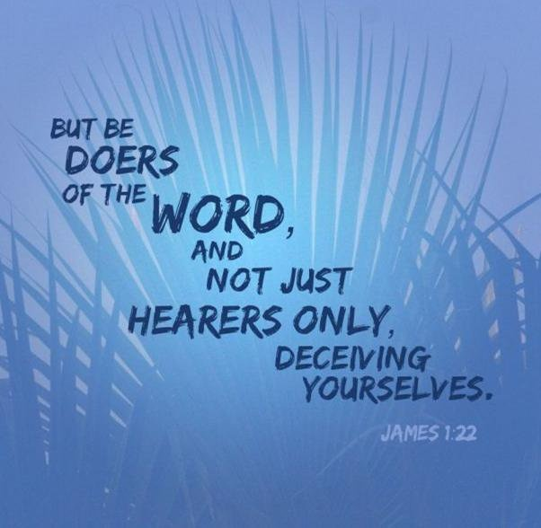
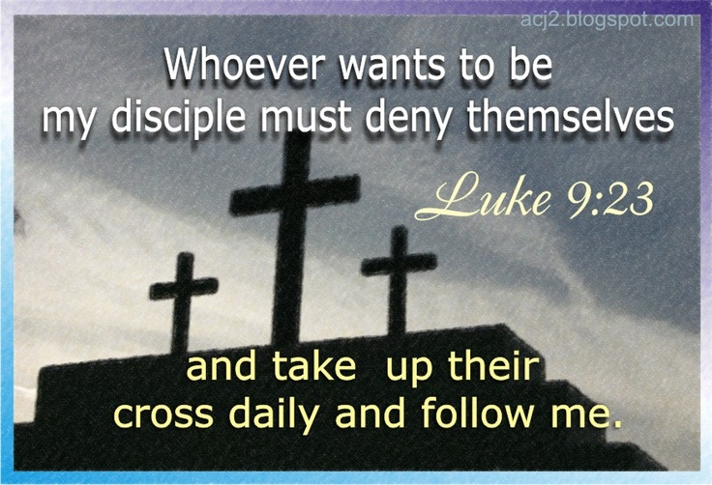
Watcher = You
Daily quiet time
Prayer
Bible
Devotions
Serving
Christian music
Doing the Word (James 1: 22)
Take up cross daily to die to self (Luke 9: 23-24)

Slide 5
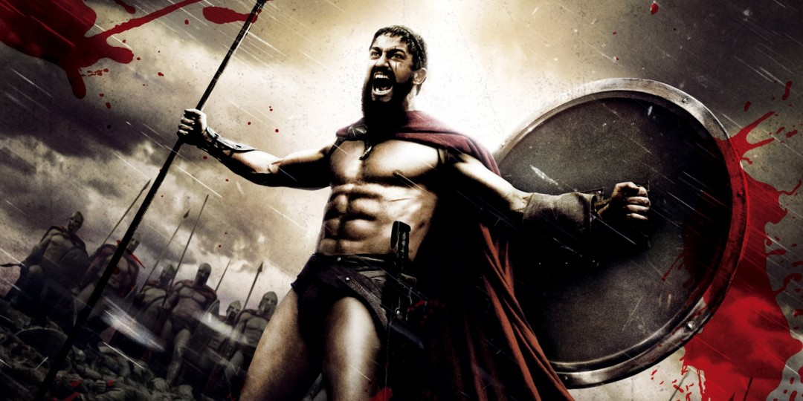

Warriors = Trusted Friends
Weekly meetings
Face-to-face or phone
E-mail for check-in
Ask the hard questions
Confront convincingly
Pray together
Fellowship/ live life
Iron sharpens iron! (Proverbs 27: 17)
Two better than one (Ephesians 4: 9)
Go into battle together!

Slide 6
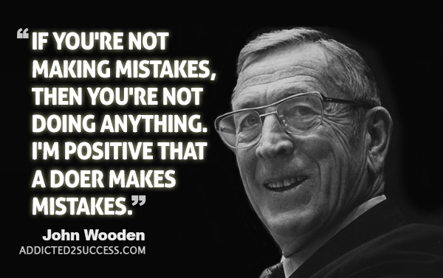

Watchman =
Trusted Mentor
Pours wisdom into you
Preferably not in family (bias)
Shares life experiences
Helps navigate life
Applies Biblical principles to life
Timothy had Paul
Passing the torch (2 Timothy 2: 2)
Who is your John Wooden?

Slide 7
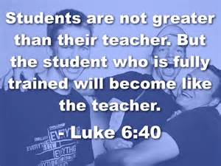
Workman = Mentee
You pour wisdom into them
Help them navigate life
Help apply Biblical principles
Relate your own stories to them
Find someone similar to you
You ask the hard questions
Luke 6: 40

Slide 8
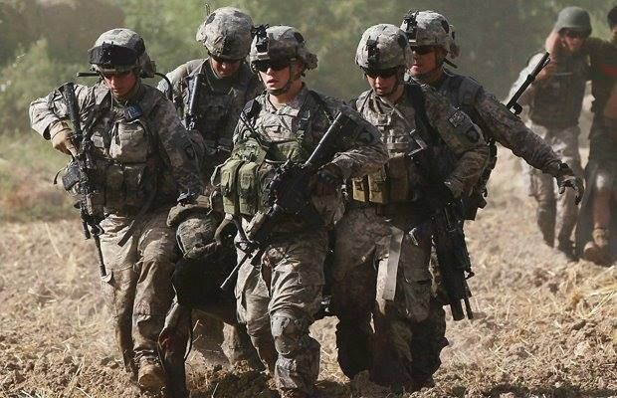
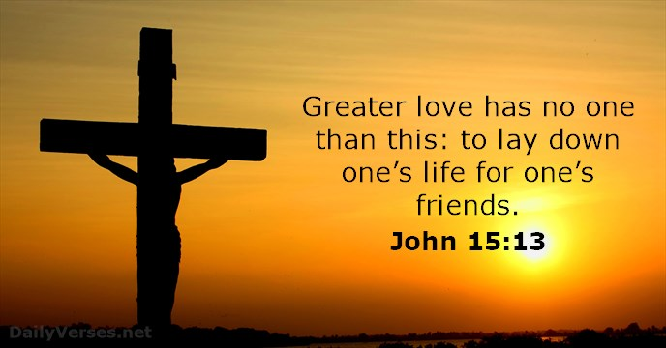
My Dream Team
Warrior: Terry
  Weekly phone calls, e-mail checkin, face-to-face
Extended Warriors: small group
  Friday at Starbucks
Watchman: Craig
  Coffee on occasions; church check-ins; phone calls
Workman: Trevor
  Sunday afternoon meetings; e-mail check-in
My dream team in action (Spring Break to now)

Slide 9
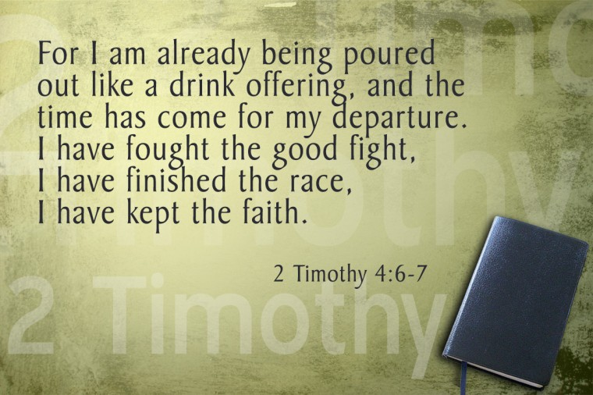
Assemble Your Team
Warriors first: same stage as you
Watchman next: seek their wisdom
Workman last: pour yourself out
Watcher: no days off; take up cross daily
Voids to fill? Pray about it.
Recruit carefully
Cut when needed
Live life together
Finish the race together

